Slide 1
Macromolecules
Enzymes
Introduction to Biology

Slide 2
Instructor Resources (This slide does not appear while presenting)
Aurum Science: Biology Teaching Resources
Student Notes Outline
Study Guide
Written by James Dauray

Slide 3
Valence Electrons
Valence electrons are electrons in the outermost level of the atom.
Elements are considered chemically stable when they have 8 valence electrons.
This is called the octet rule.
Helium: 8 valence electrons (stable)
Potassium: 1 valence electron
Reactive: Gives away the electron easily
Chlorine: 7 valence electrons
Reactive: Takes an electron easily

Slide 4
The Chemistry of Carbon
Carbon has exactly 4 valence electrons.
Easiest to share electrons with other elements.
This forms covalent compounds.
There are millions of molecules that contain carbon. These are called organic compounds.

Slide 5
Overview: The Molecules of Life
Macromolecules are large organic molecules made of thousands of atoms of carbon and other elements can be bonded together.

Slide 6
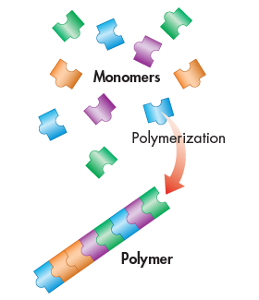
Types of Organic Molecules
The four classes of organic molecules are:
Carbohydrates
Proteins
Lipids
Nucleic acids
Every organic molecule except lipids is a polymer, or a molecule made up of repeating parts.

Slide 7
The Diversity of Polymers
An immense variety of polymers can be built from a small set of monomers.
From the same three types of simple sugars you can make:
Starch (energy storage in plants)
Glycogen (energy storage in animals)
Table sugar
Milk sugar
Cellulose (plant fiber)
Chitin (insect exoskeletons)
3
H
HO

Slide 8
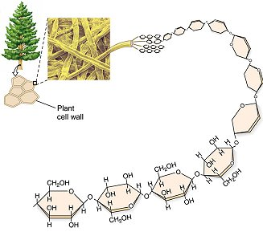
Starch: A carbohydrate polymer
Starch, a plant energy storage molecule, is made of thousands of glucose monosaccharides linked together.

Slide 9
Carbohydrates
Carbohydrates include sugars and the polymers of sugars
Made of carbon, hydrogen, and oxygen.
Carbohydrates are the main source of energy for all life.
Starch
Glucose
Sucrose

Slide 10
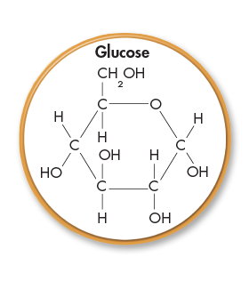
Sugars
Monosaccharides are the simplest carbohydrate, made from only one sugar molecule.
Glucose (Blood sugar)
Galactose (Part of milk sugar)
Fructose (Fruit sugar)
Monosaccharides serve as a major fuel for cells and as raw material for building molecules

Slide 11
Sugars
Disaccharides are molecules made of two monosaccharides bonded together.
Sucrose: glucose + fructose = table sugar
Lactose: galactose + glucose = milk sugar
Maltose: glucose + glucose = alcohol sugar

Slide 12
Polysaccharides
Polysaccharides are polymers (made of more than two) of sugars.
Polysaccharides have two main purposes in living things:
Providing structure
Energy storage

Slide 13
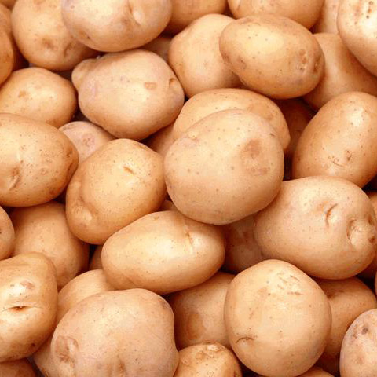
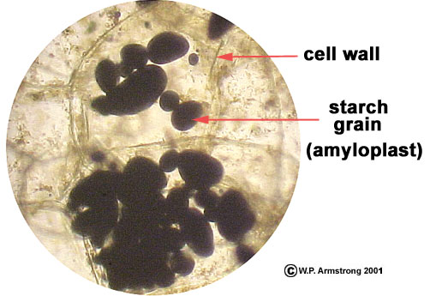
Storage Polysaccharides
Starch, a storage polysaccharide of plants.
Made entirely of glucose molecules joined together.
Plants store surplus starch within their cells.

Slide 14
Glycogen is a storage polysaccharide in animals
Very similar molecule to starch.
Humans and other vertebrates store glycogen mainly in liver and muscle cells
This is an energy reserve utilized for immediate bursts of activity.
When endurance athletes “hit the wall”, they have run out of glycogen.

Slide 15
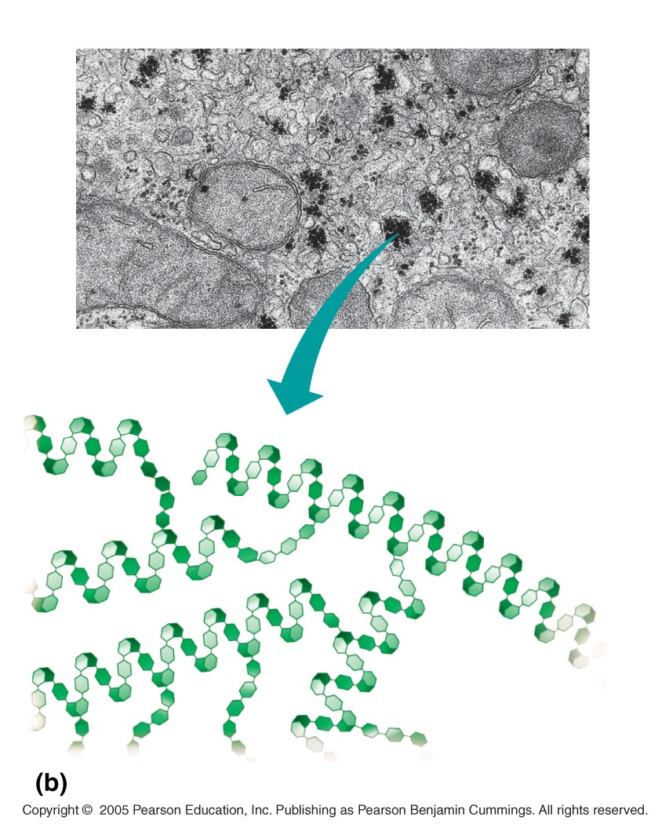
LE 5-6b
Mitochondria
Glycogen granules
0.5 µm
Glycogen
Glycogen: an animal polysaccharide

Slide 16
Structural Polysaccharides
Cellulose makes the strongest part of the cell wall of plants.
Allows plants to be sturdy and rigid.
Cellulose is very similar to starch and is also made from glucose molecules.
The bonds between the glucose molecules are slightly different.
These molecules are only digestible by herbivores.

Slide 17
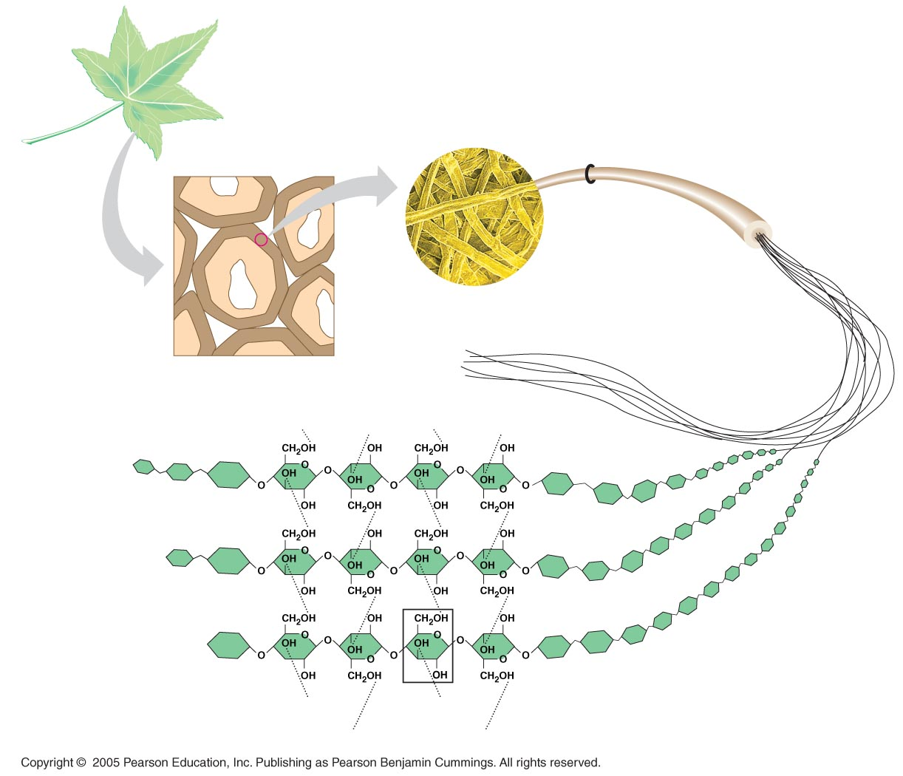
LE 5-8
Cellulose microfibrils
in a plant cell wall
Cell walls
Microfibril
0.5 µm
Plant cells
Cellulose
molecules
β Glucose
monomer

Slide 18
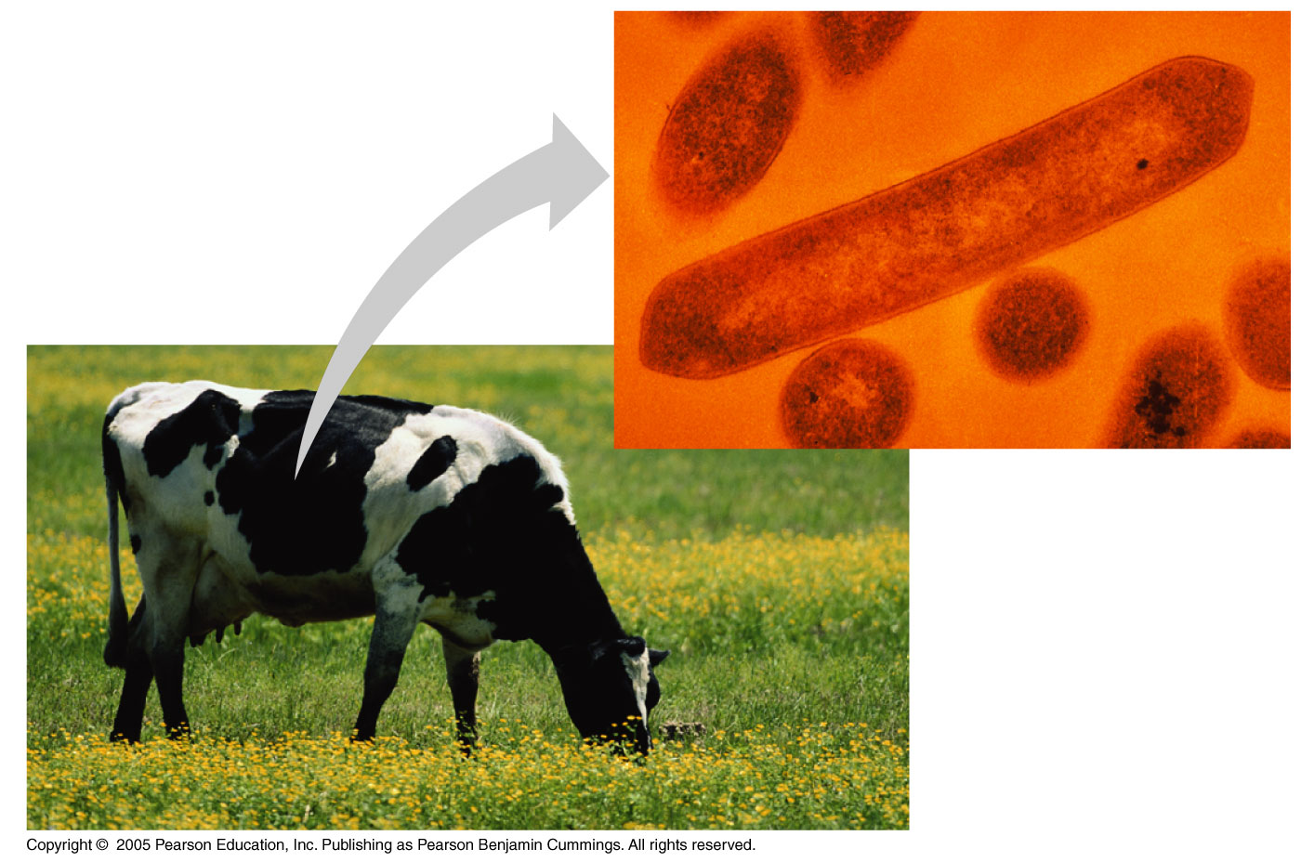
Many herbivores, from cows to termites, have symbiotic relationships bacteria to help them digest cellulose.

Slide 19
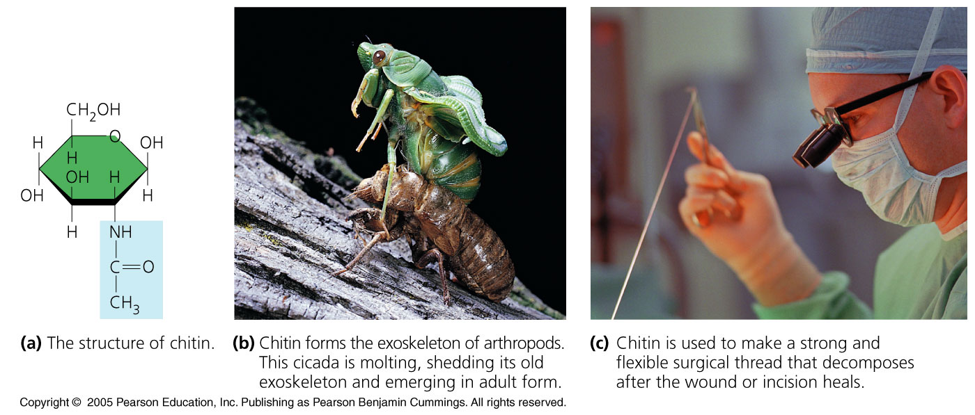
Chitin, another structural polysaccharide, is found in the exoskeleton of insects and the cell walls of fungi.
Chitin can be used as surgical thread because it is gradually reabsorbed by the body.
Chitin is not very digestible; only species that eat mainly insects can break it down easily.

Slide 20
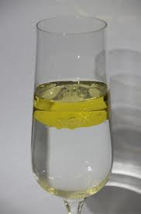
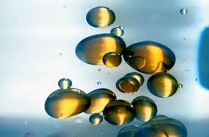
Lipids
Lipids do not form polymers
Lipids are considered hydrophobic because they cannot dissolve in water.
The most biologically important lipids are fats, phospholipids, and steroids.

Slide 21
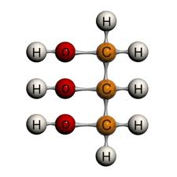
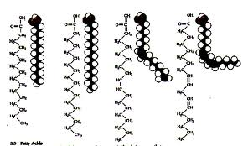
Fats
Fats are constructed from two types of smaller molecules:
Glycerol
Connects three fatty acids together
Three Fatty acids
Very long chains of carbon, hydrogen, and oxygen
Contain most of the energy of the molecule

Slide 22
Fatty acids vary in two ways:
length (number of carbons)
If they have any double bonds
Saturated fatty acids have the maximum number of hydrogen atoms possible and no double bonds
Unsaturated fatty acids have one or more double bonds

Slide 23
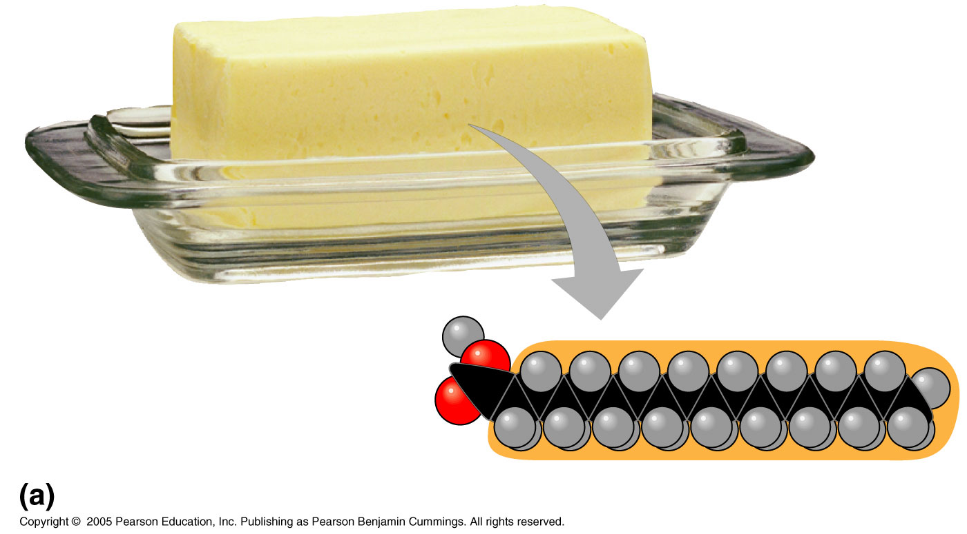
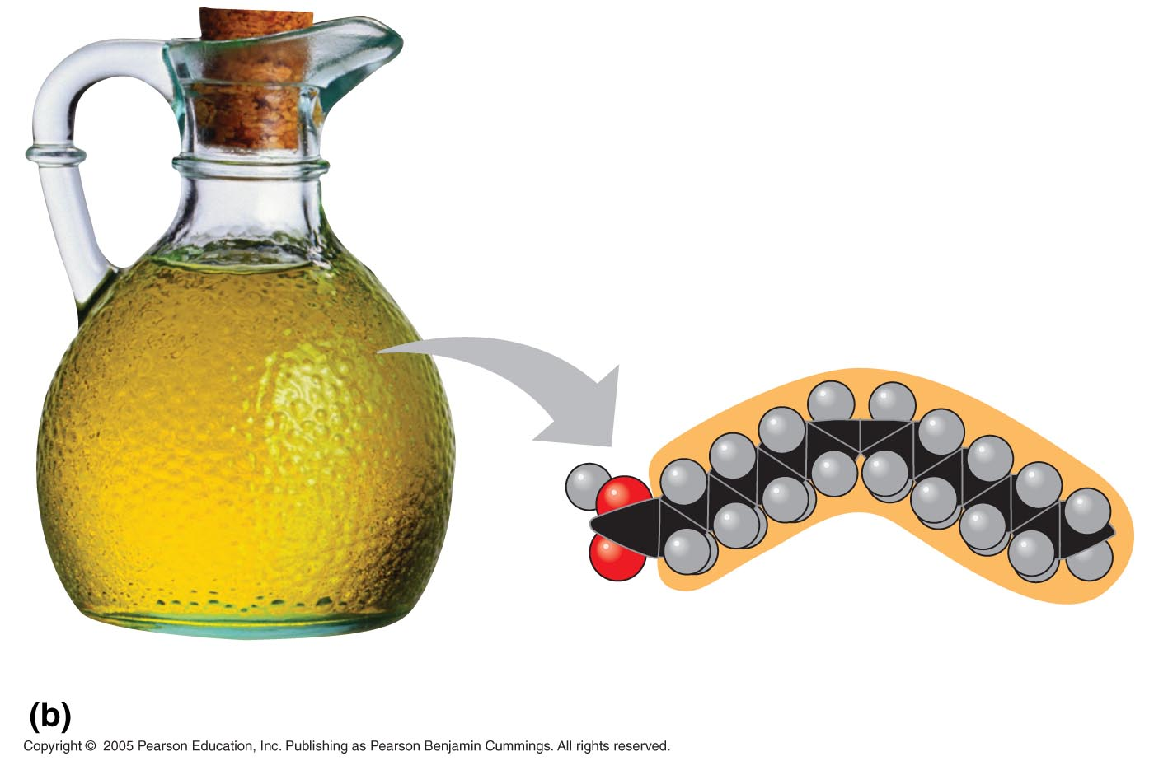
Saturated fats most often come from animal sources and are solid at room temperature.
They have a straighter shape can be packed more tightly together.
Unsaturated fats usually come from plant sources or fish and are liquid at room temperature.
Curved shape due to double bonds

Slide 24
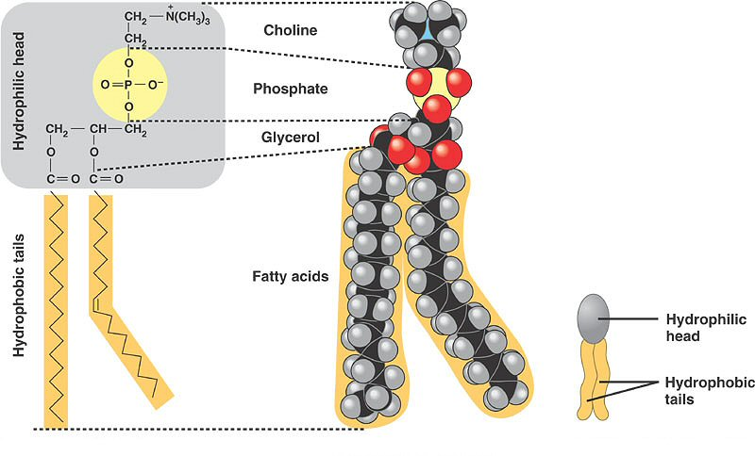
Phospholipids
In a phospholipid, one of the fatty acids is replaced by a phosphate (PO₄).
The two fatty acid tails are hydrophobic, but the phosphate head is hydrophilic.

Slide 25
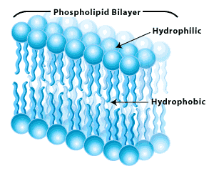
When phospholipids are added to water, they self-assemble into a bilayer
The phospholipids form the outer part that is in contact with the water.
The fatty acids form the inner part that is away from water.

Slide 26
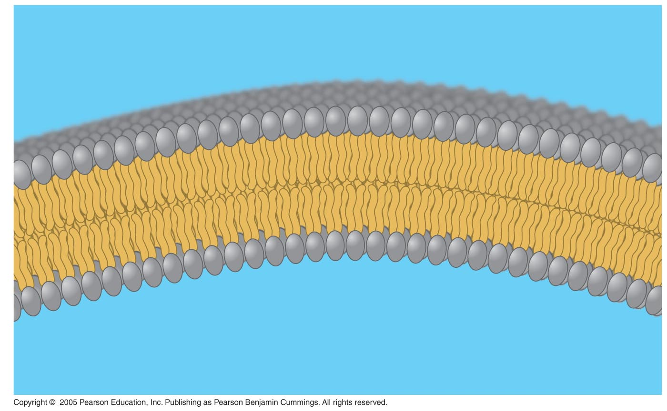
Hydrophilic
head
WATER
Hydrophilic
head
WATER
Hydrophobic
tails
WATER
WATER
This phospholipid bilayer creates the basic structure of all cell membranes.

Slide 27
Proteins
Proteins account for more than 50% of the dry mass of most cells
Protein functions include
structural support,
storage, transport,
cellular communications,
movement, and
defense against foreign substances

Slide 28
Protein Structure
Proteins are made of chains of amino acids.
There are only 20 amino acids, but they can be combined in nearly infinite ways.
The sequence of amino acids determines the shape of the protein.
The shape of the protein is the biggest factor that determines its function.

Slide 29
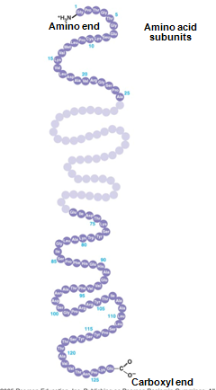
Four Levels of Protein Structure
Primary structure is the sequence of amino acids in a protein.
Compare to the order of letters in a long word.
Primary structure is directly determined by the DNA sequence in the nucleus.

Slide 30
Secondary structure is the folding or coiling of a protein chain.
This is caused by hydrogen bonds that occur between different amino acids.
Two types of secondary structure:
Helix (spiral shape)
Pleated (folded) sheet

Slide 31
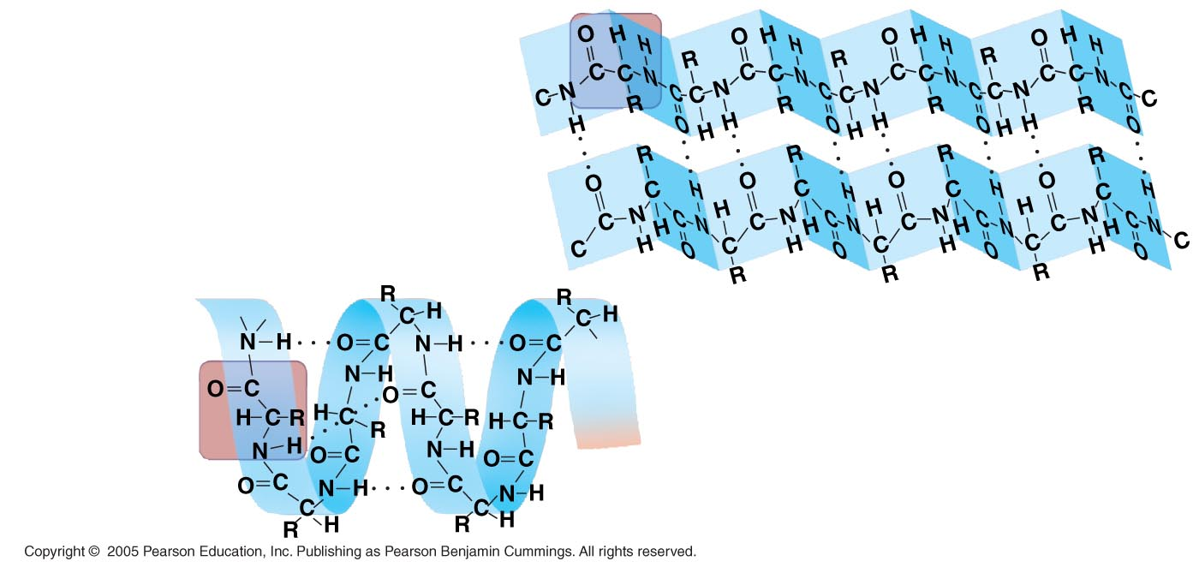
Secondary Protein Structure
Amino acid
subunits
Amino acid
subunits
β pleated sheet
α helix
β pleated sheet
α helix

Slide 32
Tertiary structure is actual 3D shape of the protein.
Can be caused by any hydrogen bonds, ionic bonds, and Van der Waals interactions within the protein molecule.
Disulfide bonds between atoms of sulfur within the amino acids can also be formed.
This is what makes hair curly!

Slide 33
Tertiary Structure – Disulfide Bonds
Disulfide bonds can form between atoms of sulfur within the protein
This is what makes hair curly!
This is also what makes burnt hair smell so bad.

Slide 34
Polypeptides are small proteins with short amino acid chains.
Quaternary structure results when two or more smaller polypeptides with different shapes join together.
Example: Hemoglobin in blood
Hemoglobin is made of four polypeptides.

Slide 35
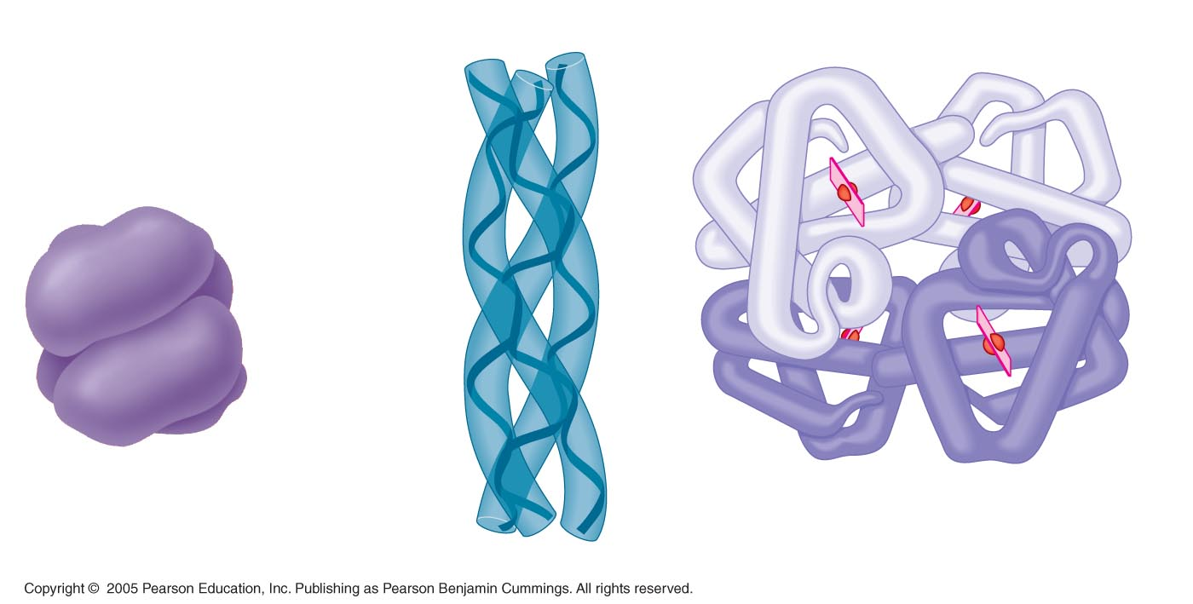
LE 5-20e
Polypeptide
chain
β Chains
Iron
Heme
α Chains
Hemoglobin
Polypeptide chain
Collagen

Slide 36
Sickle-Cell Disease
A slight change in primary structure can drastically change the entire shape of the protein.
When a protein changes shape, it will not work the same.
Sickle-cell anemia is a genetic disease that occurs when red blood cells are shaped like crescents or sickles instead of saucers.
Result: Not enough oxygen gets through the body, making the person become tired very easily.

Slide 37
LE 5-21a
The single gene that is affected changes one single amino acid in the primary structure of hemoglobin.
10 µm
10 µm
Red blood
cell shape
Normal cells are
full of individual
hemoglobin
molecules, each
carrying oxygen.
Red blood
cell shape
Fibers of abnormal
hemoglobin deform
cell into sickle
shape.
This affects the secondary structure, which affects the tertiary structure, which affects the quaternary structure.

Slide 38
What Determines Protein Conformation?
Protein shape can also be affected by temperature and pH changes.
When a protein loses its normal shape, this is called denaturing.
A denatured protein is biologically inactive.
Denaturing is usually permanent and not reversible.

Slide 39
Enzymes
Enzymes are a type of protein that acts as a catalyst, speeding up chemical reactions
Enzymes can perform their functions repeatedly, functioning as workhorses that carry out the processes of life.

Slide 40
Chemical Reactions
A chemical reaction is a process that changes, or transforms, one set of chemicals into another by changing chemical bonds.
Energy and mass can change form in chemical reactions but they cannot be created or destroyed.
Reactants enter a chemical reaction and are turned into products.

Slide 41
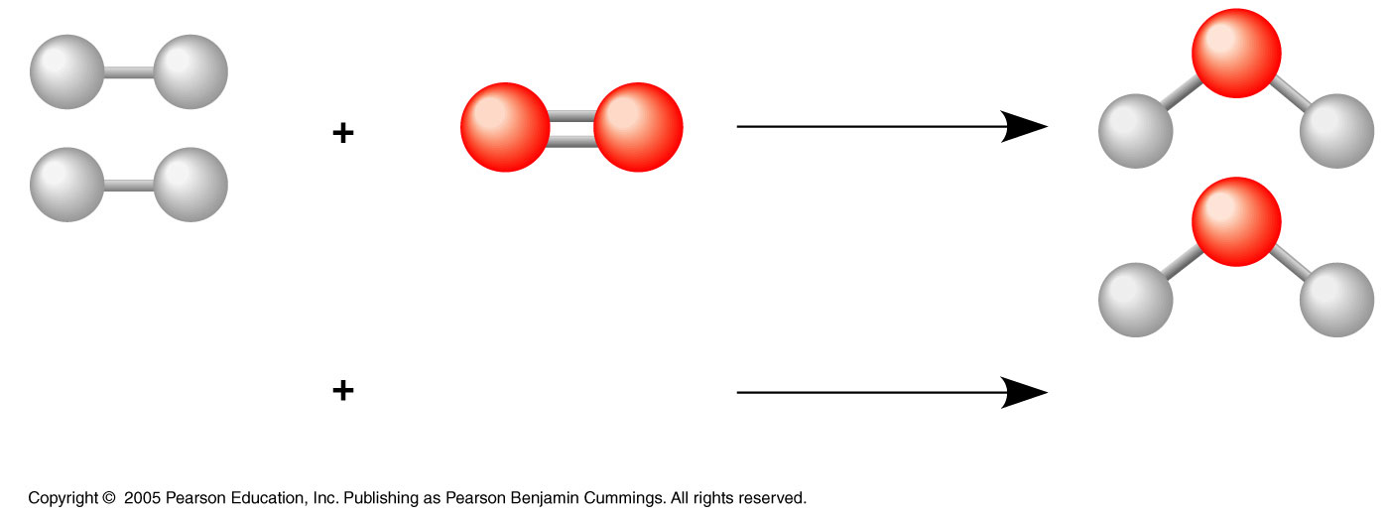
LE 2-UN44
2 H₂
O₂
Reactants
Reaction
2 H₂O
Products

Slide 42
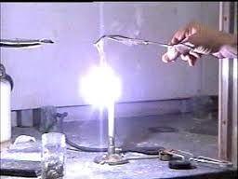
Chemical Reactions
Every chemical reaction has an activation energy, which is energy required to actually start the reaction.
Example: Synthesis of magnesium oxide
2 Mg(s ) + O₂(g ) --> 2 MgO(s )
This reaction cannot start unless a flame is present first.

Slide 43
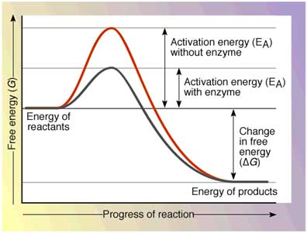
Enzymes and Chemical Reactions
Enzymes lower the activation energy of a chemical reaction, making it occur more easily and quickly.

Slide 44
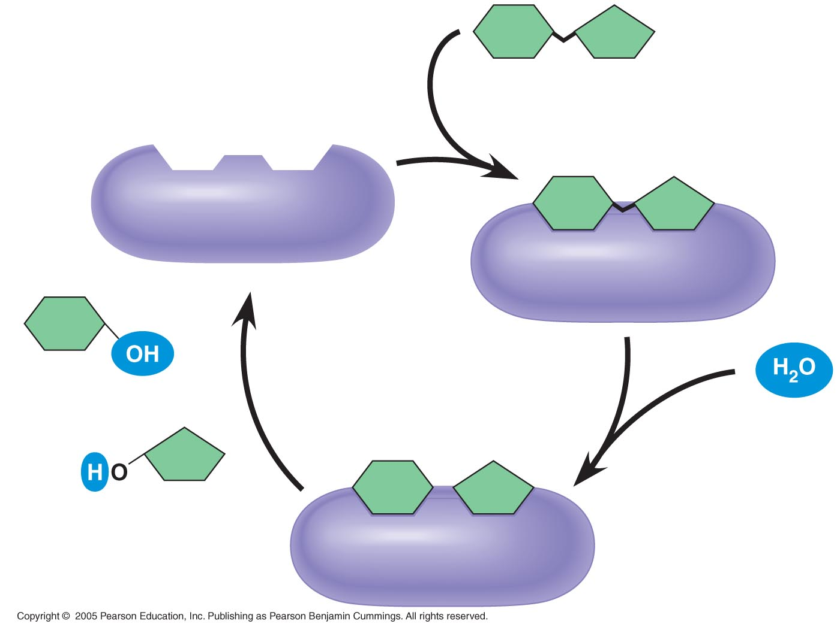
LE 5-16
Substrate
(sucrose)
Glucose
Enzyme
(sucrose)
Fructose

Slide 45
Enzyme Shape
Enzymes are highly specific protein molecules based on shape.
Each enzyme shape only fits a specific molecule
If the shape of the enzyme changes, it will no longer function.

Slide 46
The Digestive System
There are hundreds of enzymes in use throughout the human body.
The digestive system in particular makes use of a series of enzymes to complete its necessary reactions.

Slide 47
The Mouth
Mainly for mechanical digestion
Food is broken down into smaller pieces with more surface area for digestion.
Saliva
98% water, allows for mixing of food and easier swallowing
Also contains two enzymes: amylase and lipase

Slide 48
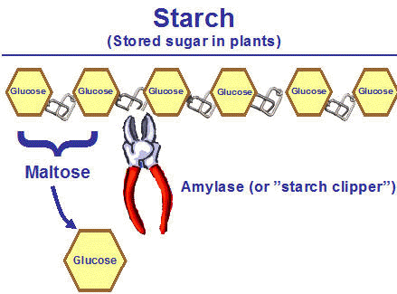
Salivary Enzymes
Amylase is an enzyme that catalyzes the hydrolysis of starch (polysaccharide) into maltose (disaccharide).
Amylase has an optimal pH of 7.4 and temperature close to body temperature.

Slide 49
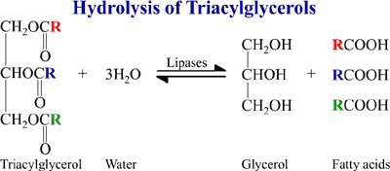
Salivary Enzymes
Lipase is an enzyme that catalyzes the hydrolysis of a fat into its three fatty acids.
Lipase has an optimal pH of about 4.0. It is not activated until it reaches the stomach.

Slide 50
Stomach Enzymes
The stomach is a highly acidic environment with a pH close to 2.0.
Stomach cells release HCl, which disassociates into H⁺ and Cl⁻ ions in water.
The main enzyme of the stomach is pepsin, which breaks down large proteins and polypeptides into smaller polypeptides.
Optimal pH of 1.5-2.0.

Slide 51
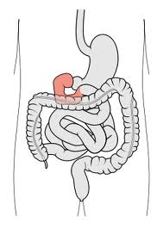
Small Intestine
Most enzymatic digestion of macromolecules occurs in the small intestine.
The first section of the small intestine, the duodenum, is considered a “crossroad” in digestion because it mixes digestive juices from so many organs.

Slide 52
Pancreatic Secretions
The pancreas releases a solution of bicarbonate and enzymes into the duodenum.
Bicarbonate is an ion (HCO³-) that can combine with H⁺ ions in solution.
This makes it a buffer against acids.
Trypsin breaks polypeptides into amino acids
Optimal pH of 8.0

Slide 53
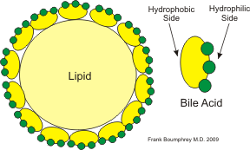
The Liver
The liver released bile stored in the gall bladder into the duodenum.
Bile has a hydrophobic and a hydrophilic side.
The hydrophobic side is attracted to the fat molecules, causing fat droplets to be surrounded by bile molecules.
This divides the fat into much smaller molecules with more surface area.

Slide 54
Small Intestine Enzymes
Other enzymes are produced by the small intestine itself:
Lactase: Hydrolyzes lactose into glucose and galactose.
Sucrase: Hydrolyzes sucrose into glucose and fructose.
Maltase: Hydrolyzes maltose into two glucose molecules.

Slide 55
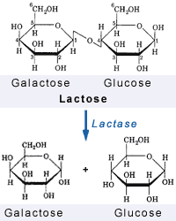
Lactase
Lactase is an enzyme that is produced in high amounts in mammals only.
Mainly while milk-fed.
In most populations, lactase is produced in much smaller amounts after weaning.
A single mutation that occurred 5,000-10,000 years ago allows the enzyme to be made throughout life.

Slide 56
Lactase
Frequency of lactase gene mutation:
Northern Europe: 95% of population
Sicily: 29% of population
Most of Asia and Africa: 10% of population
Ingestion of lactose-heavy foods (i.e. milk) when the enzyme is not present results in lactose intolerance.

Slide 57
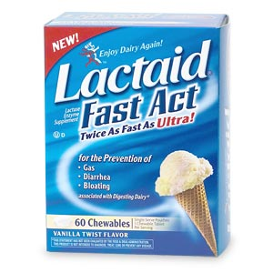
Lactose Intolerance Symptoms
Lactose passes undigested into large intestine.
Intestinal bacteria begin to ferment the lactose, resulting in the production of methane, carbon dioxide, and hydrogen sulfide.

