Slide 1
Evolution and Natural Selection
Introduction to Biology

Slide 2
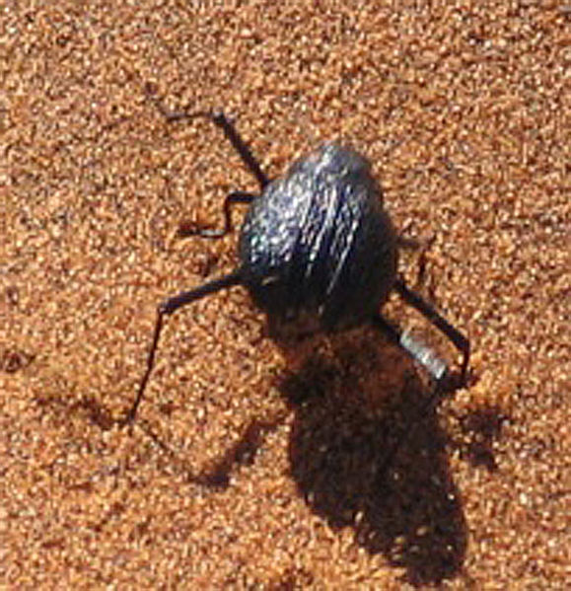
The “Fog-Basking” Beetle
The “Fog-Basking” Beetle is a species that only lives in the deserts of southwestern Africa.
This beetle has an unusual behavior – it stands on its head.
This allows the beetle to collect water from the fog that passes by on its body.
The water then runs down into its mouth.

Slide 3
This is a behavioral adaptation, a specific action that increases its chances of survival.
Most of the beetle’s other characteristics are the same as every other beetle on Earth.
Hard shell
Six legs
Two pairs of wings
How did this new species of beetle evolve?
What is its relationship with other beetles?

Slide 4
Evolution
Evolution is the theory that every species that exists on Earth is a descendent of an ancient ancestor.
If you were to trace the history of any two species back far enough, they should eventually intersect.
All species have a common ancestor.

Slide 5
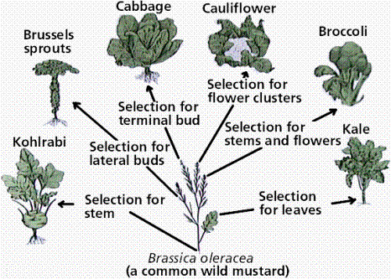
Vegetable Evolution
Many of the green vegetables we eat came from the same original ancestor, and were bred for different characteristics.
This is an example of artificial selection, because these breeds were created by human action.

Slide 6
Evolution and Creationism
Before the theory of evolution was proposed, most of the world believed in some form of creationism, where all species were created by a supernatural being.
This belief was held very strongly up through the mid-1800s.

Slide 7
Fossils, Cuvier, and Catastrophism
The study of fossils helped to lay the groundwork for the development of the theory of evolution.
Fossils are remains or traces of organisms from the past, usually found in layers of rock.
Each layer of rock is called a stratum.
The stratum on the surface contains younger fossils.
The stratum deep below the surface contains older fossils.

Slide 8
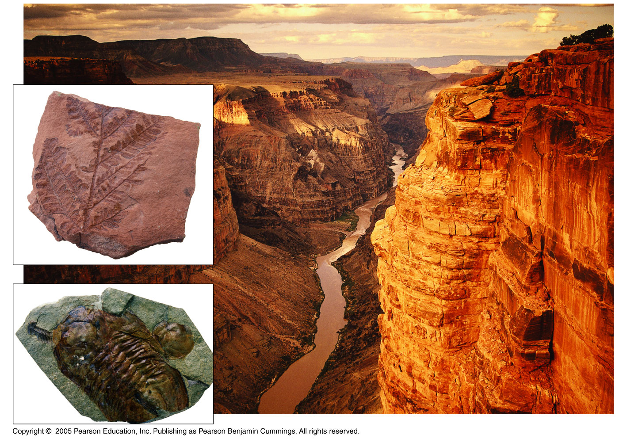
Grand Canyon

Slide 9
Cuvier and Paleontology
Paleontology, the study of fossils, was largely developed by French scientist Georges Cuvier
Cuvier made two observations from studying fossils:
Younger fossils were much more similar to living species than older fossils.
Between each layer of rock, some species disappeared, while other new ones appeared.

Slide 10
Cuvier and Paleontology
Cuvier had observed two phenomena:
Speciation, or the emergence of a new living species.
Extinction, or the complete disappearance of a species.
His theory to explain this, called catastrophism, stated that each boundary line between strata represented a natural disaster that wiped out some of the species.
Example: A great flood

Slide 11
Theories of Gradualism
Other scientists believed in gradualism.
This is the idea that profound change can take place through the cumulative effect of slow but continuous processes.

Slide 12
Geologists Hutton and Lyell theorized that changes in Earth’s surface can result from slow continuous actions still operating today.
For example, valleys can be formed by rivers flowing through them and eroding the soil over time.
This view strongly influenced Charles Darwin
If slow, continuous changes occur in the Earth, they can also occur with life.

Slide 13
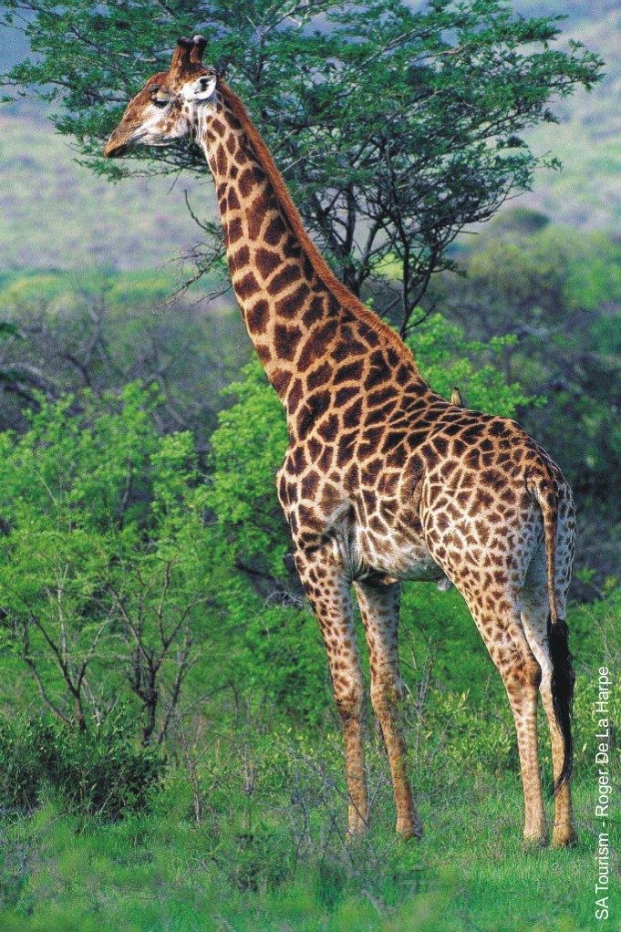
Lamarck’s Theory
Lamarck hypothesized that can evolve new traits based on their actions and lifestyle.
According to his theory, the giraffe developed its long neck by stretching it to eat from trees.
This is called an acquired trait because it developed over a single lifetime.

Slide 14
As the 19th century dawned, it was generally believed that species had remained unchanged since their creation
However, a few doubts about the permanence of species were beginning to arise

Slide 15
Darwin’s Research
As a boy and into adulthood, Charles Darwin had a consuming interest in nature
Darwin’s father sent him to medical school, but he found medicine to be boring and quit.
He enrolled at Cambridge University to be become part of the clergy of the church.
Most scientists at this time were also clergymen.
After graduation, he went on a voyage around the world on a ship called the HMS Beagle.

Slide 16
The Voyage of the Beagle
During his travels on the Beagle, Darwin was able to observe adaptations of plants and animals from many diverse environments.
Rainforests of Brazil
Grasslands of Argentina
Mountains of Peru
One of the most important visits he made was to the Galápagos Islands west of South America

Slide 17
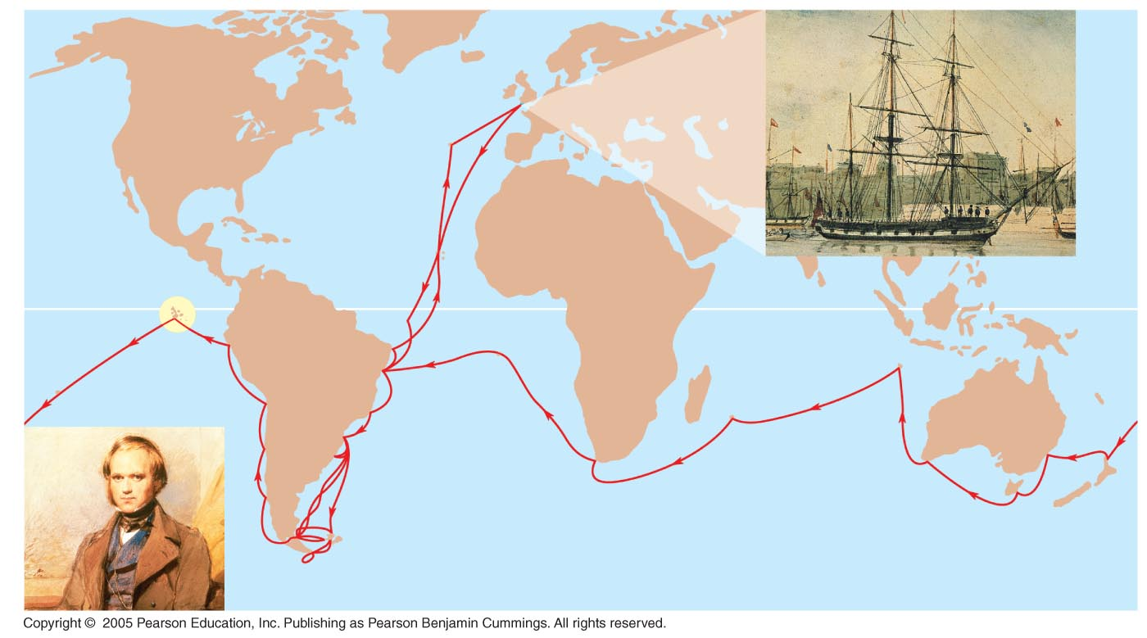
LE 22-5
England
EUROPE
NORTH
AMERICA
PACIFIC
OCEAN
ATLANTIC
OCEAN
Galápagos
Islands
AFRICA
HMS Beagle in port
SOUTH
AMERICA
Equator
Darwin in 1840,
after his return
AUSTRALIA
Andes
Cape of
Good Hope
Tasmania
Cape Horn
New
Zealand
Tierra del Fuego

Slide 18
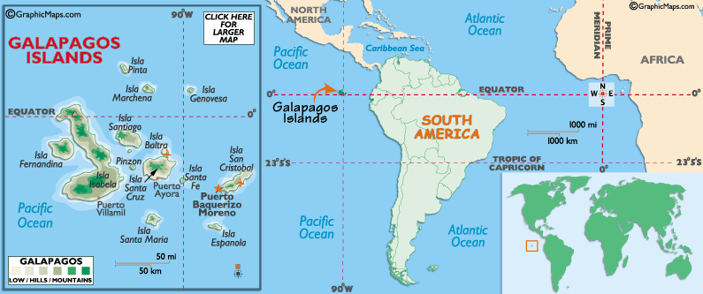
The Galapagos Islands
Darwin found animals on these islands that weren’t found anywhere else in the entire world.
He theorized that the animals had migrated from South America and then began developing specific adaptations to their new environment.

Slide 19
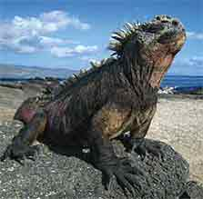
The Galapagos Islands
Darwin also noted that the animals on the Galapagos islands were amazingly unafraid of humans.
After watching a lizard that was partly buried in the sand, he wrote this:
“I then walked up and pulled it by the tail; at this it was greatly astonished, and soon shuffled up to see what was the matter; and then stared me in the face, as much as to say, “What made you pull my tail?”

Slide 20
Darwin’s Focus on Adaptation
Darwin noted many adaptations, or characteristics that enhanced the organisms chances of survival.
He began to form a theory that as organisms gradually accumulated new adaptations, they would form a new species.
One of the best examples of this theory is the different species of finches on the islands.
The birds were all very similar except for their beaks.

Slide 21
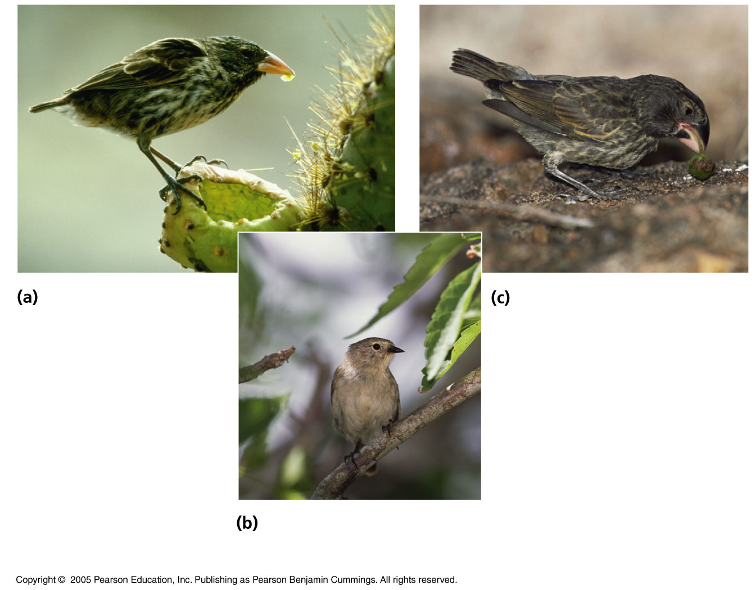
LE 22-6
The long, sharp beak of the cactus ground finch (Geospiza scandens) helps it tear and eat cactus flowers and pulp.
The large ground finch (Geospiza magnirostris) has a large beak adapted for cracking seeds that fall from plants to the ground.
The green warbler finch (Certhidea olivacea) used its narrow, pointed beak to grasp insects.

Slide 22
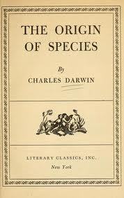
In 1844, Darwin wrote an essay on the origin of species and natural selection but did not introduce his theory publicly, anticipating an uproar.
His theory suggested that new species developed over time naturally, not directly from God.
In June 1858, Darwin received a manuscript from Alfred Russell Wallace, who had developed a theory of natural selection similar to Darwin’s.
Darwin quickly finished his book, entitled The Origin of Species and published it the next year.

Slide 23
The Origin of Species
The ideas of Origin of Species can be summarized with these two main points:
Evolution explains life’s unity and diversity.
Natural selection is a cause of evolution.

Slide 24
Descent with Modification
Darwin did not call his theory “evolution”.
He used the phrase descent with modification.
This means that all organisms are related.
All species came from a common ancestor.
In the Darwinian view, the history of life is like a tree with branches representing each new species.
Each new species is simply a “modified” version of its ancestor.

Slide 25
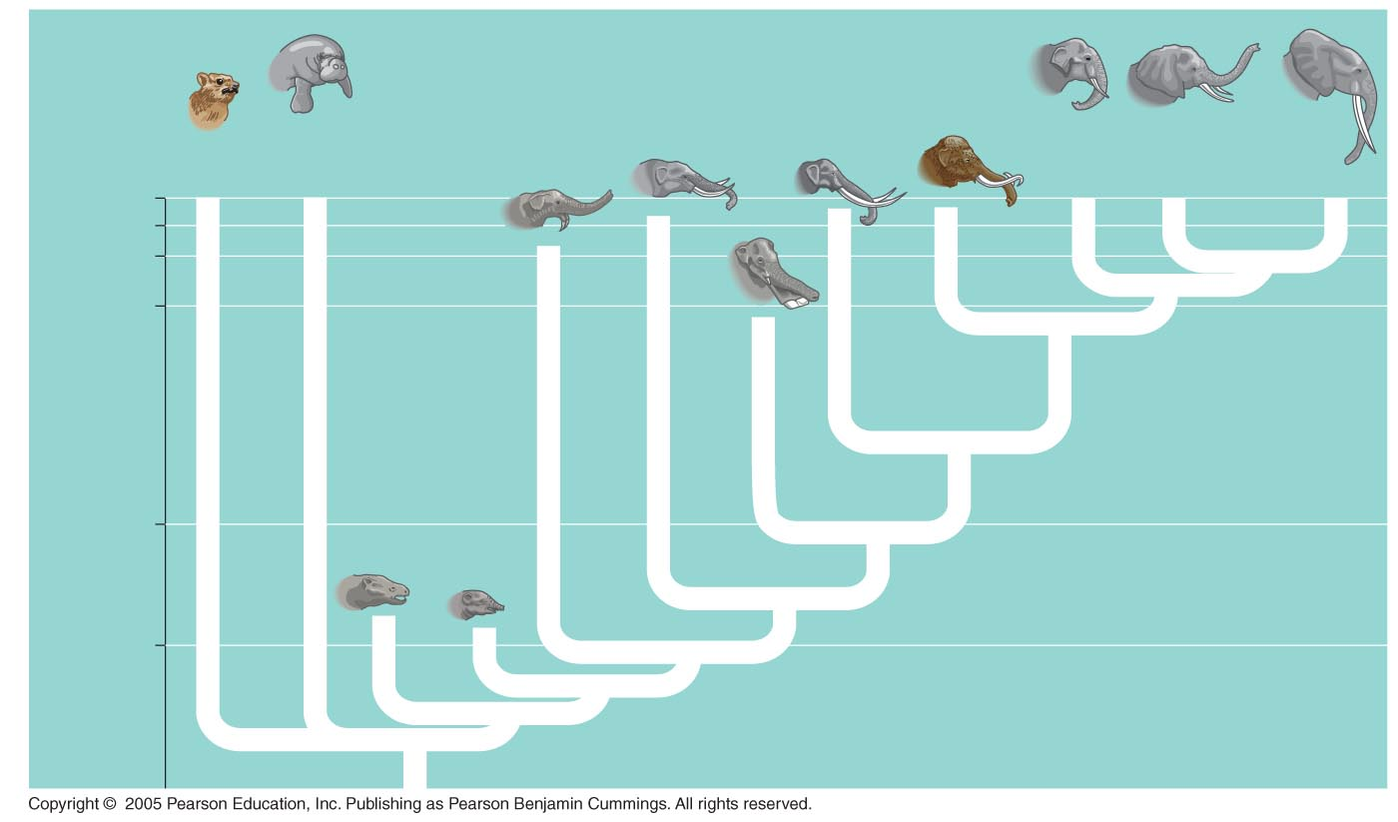
LE 22-7
Hyracoidea
(Hyraxes)
Sirenia
(Manatees
and relatives)
Elephas
maximus
(Asia)
Loxodonta
africana
(Africa)
Loxodonta
cyclotis
(Africa)
Years ago
0
10,000
2
5.5
Stegodon
Mammut
Mammuthus
Deinotherium
Platybelodon
Millions of years ago
24
Barytherium
Moeritherium
34

Slide 26
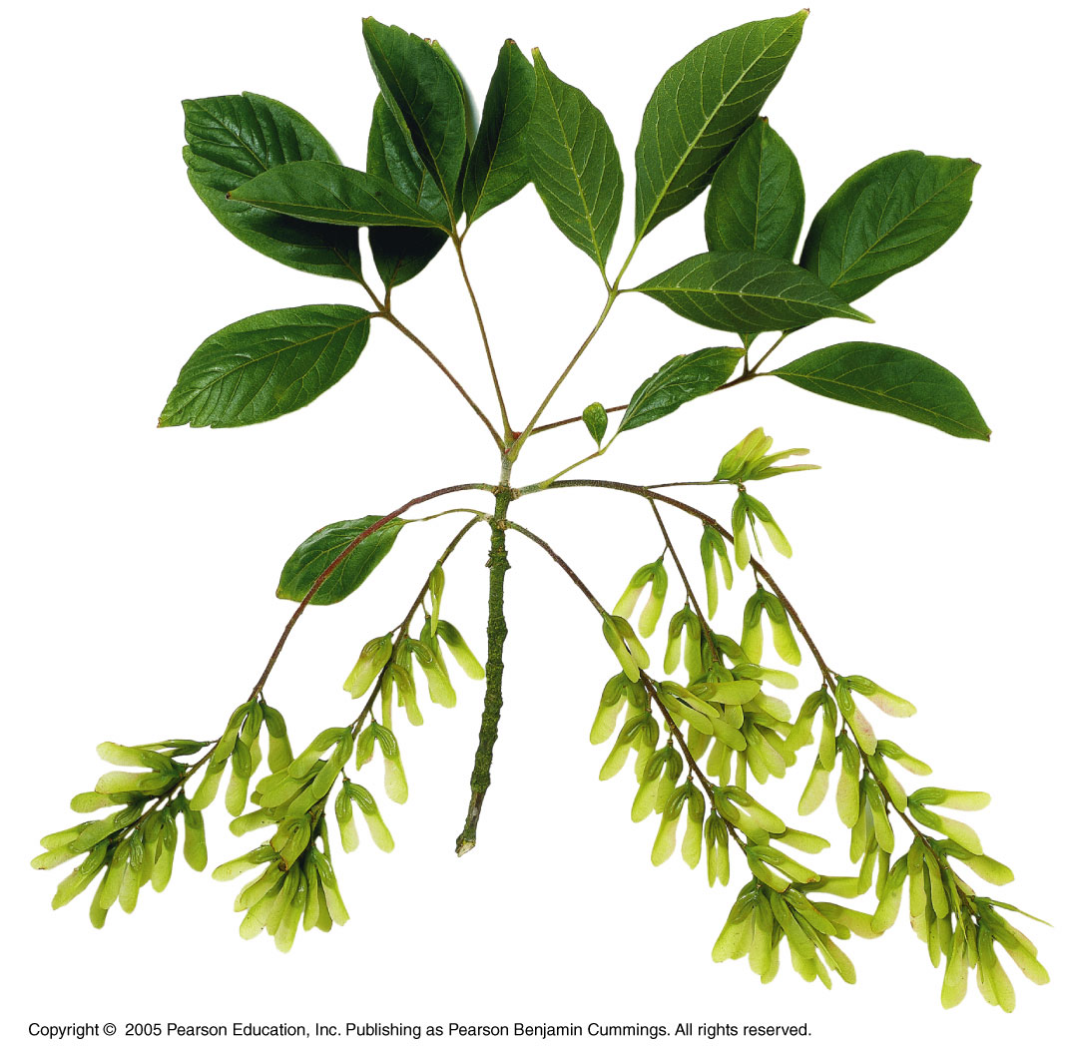
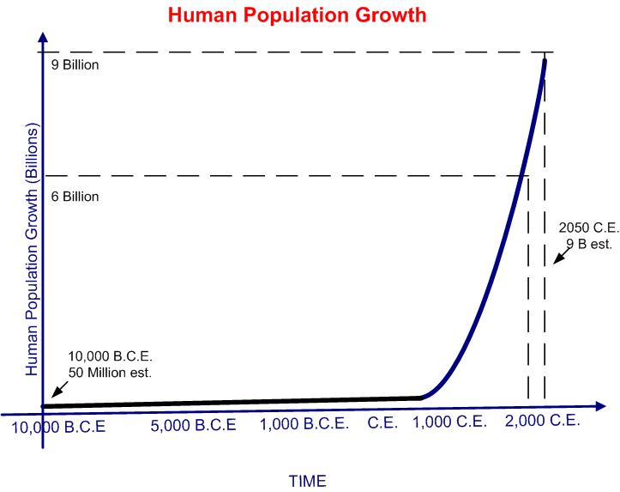
Natural Selection and Adaptation
Charles Darwin’s theory can be broken down into five different observations.
Observation #1: For any species, population sizes would increase exponentially if all individuals that are born reproduced successfully.

Slide 27
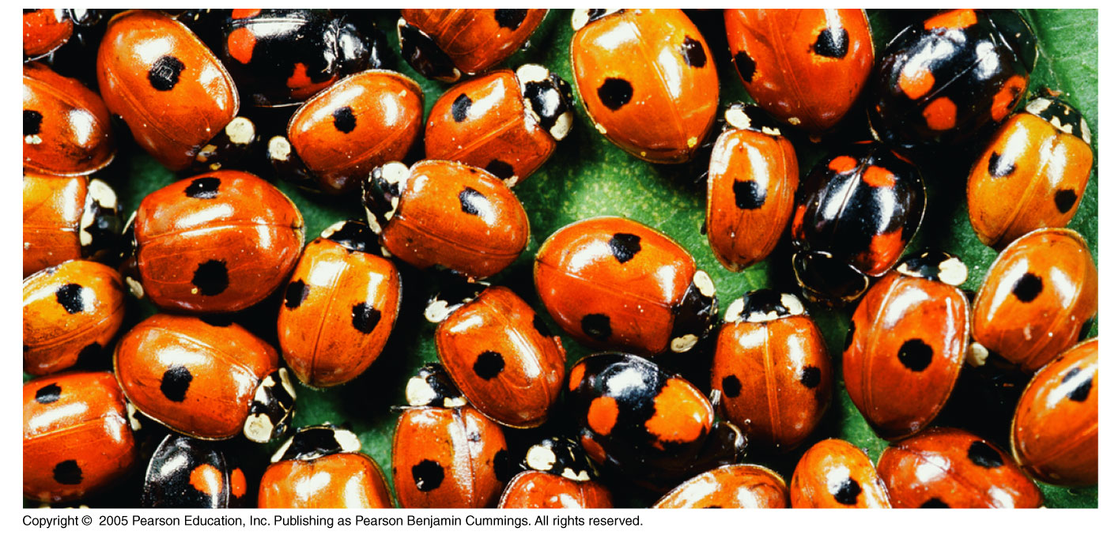
Observation #2: Populations tend to be stable in size, except for seasonal fluctuations
Observation #3: Resources are limited
Observation #4: Members of a population vary in their characteristics; no two individuals are exactly alike

Slide 28
Observation #5: Much of this variation is heritable

Slide 29
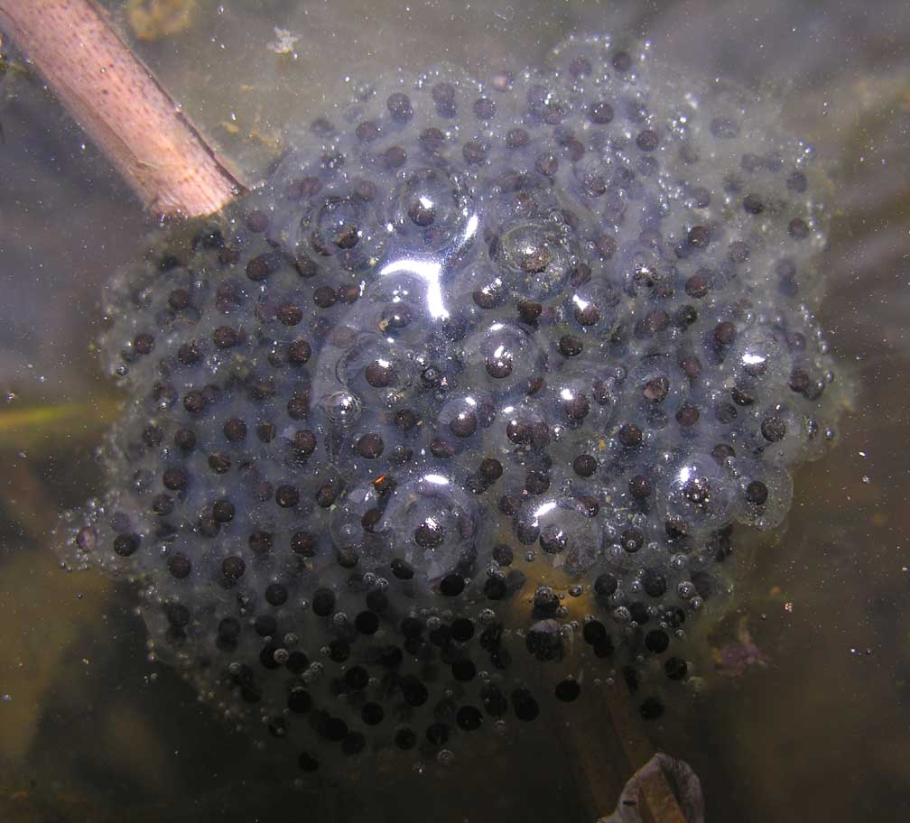
Conclusion #1: More individuals are produced than the environment can support;
Frogs lay thousands of eggs at a time, but only about 1% survive to adulthood.
Play the Roll for Survival Game!
http://www.torontozoo.com/adoptapond/3games.asp

Slide 30
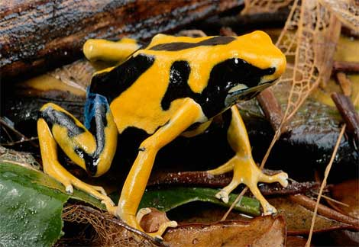
Inference #2: Survival depends in part on inherited traits.
Individuals with traits that give them an advantage are more likely to reproduce and have offspring.

Slide 31
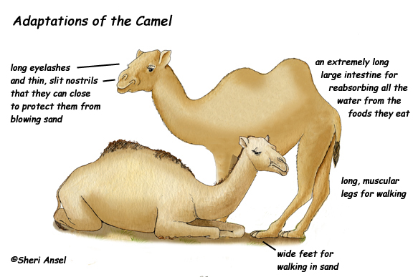
Inference #3: Individuals that reproduce the most will pass favorable characteristics to their offspring.
Over generations, these characteristics will accumulate.

Slide 32
Summary of Natural Selection
Natural selection is differential success in reproduction from interaction between individuals that vary in heritable traits and their environment
Natural selection produces an increase over time in adaptation of organisms to their environment
If an environment changes over time, natural selection may result in adaptation to these new conditions

Slide 33
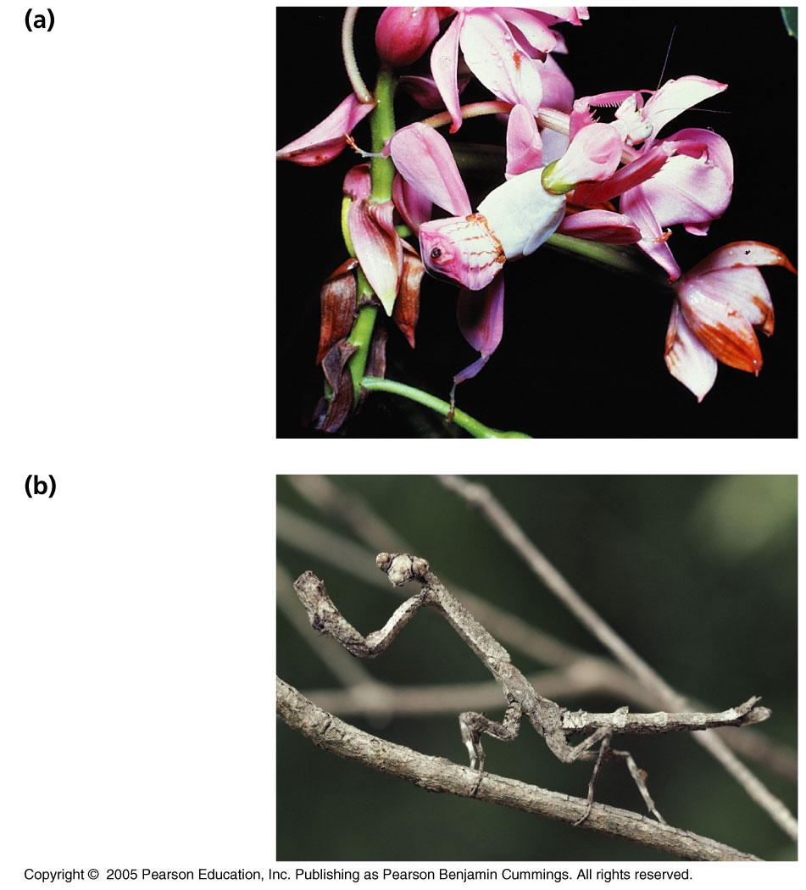
LE 22-11
A flower mantid
in Malaysia
A stick mantid
in Africa

Slide 34
Modern Application of Darwin’s Theory
Darwin’s theory of evolution continues to be tested by how effectively it can account for additional observations and experimental outcomes.

Slide 35
Case Study: Predation in Guppy Populations
The population of wild guppies were studied in two situations:
In pools containing pike-cichlids, which hunt and eat guppies intensely.
In pools containing killifish, which do not hunt the guppies as often.

Slide 36
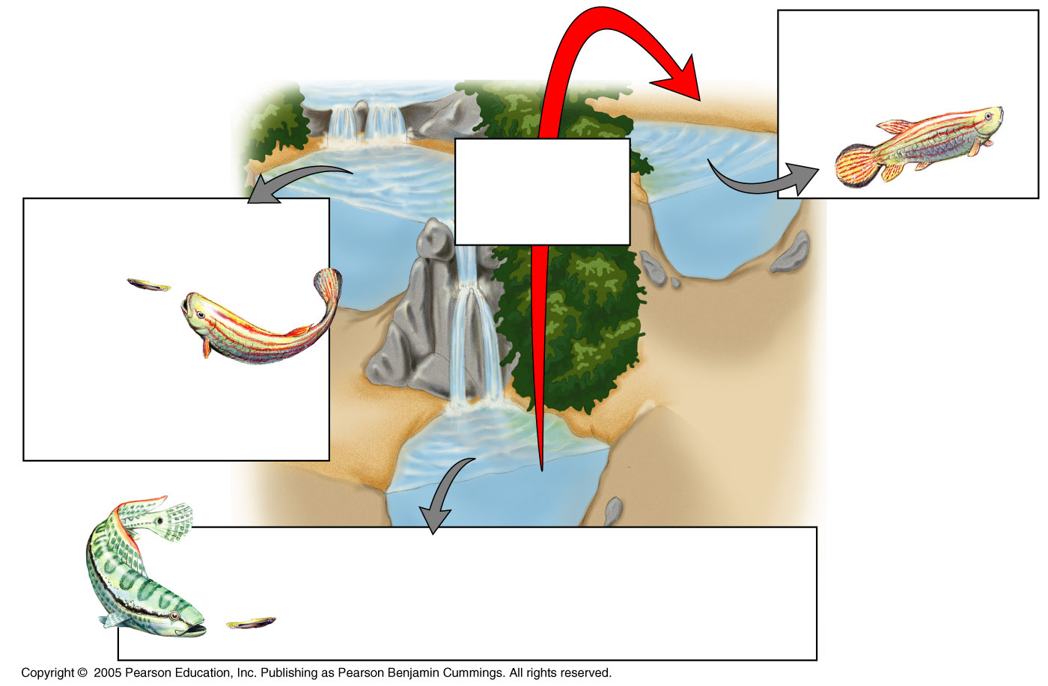
LE 22-12a
Pools with killifish
but no guppies prior
to transplant
Experimental
transplant of
guppies
Predator: Killifish; preys
mainly on small guppies
Guppies:
Larger at
sexual maturity
than those in
“pike-cichlid pools”
Predator: Pike-cichlid; preys mainly on large guppies
Guppies: Smaller at sexual maturity than
those in “killifish pools”

Slide 37
LE 22-12b
200
161.5
185.6
100
85.7
92.3
Control population:
Guppies from pools with
pike-cichlids as predators
160
80
Mass of guppies
at maturity (mg)
Age of guppies
at maturity (days)
58.2
120
60
48.5
80
67.5
76.1
40
40
20
Experimental population:
Guppies transplanted to
pools with killifish as
predators
Males
Females
Males
Females
Guppies living with the pike-cichlid predators matured much more quickly.
This is an adaptation that increased their chances of reproducing before being eaten.

Slide 38
The Evolution of Drug-Resistant HIV
Many drugs have been developed to treat HIV, but the viruses evolve resistance very quickly.
One example is a drug called Epivir, or 3TC.
This drug stops HIV from infecting healthy cells.
Initially, the drug works very well. However, over time, viruses that develop resistance to the drug survive and reproduce much more and pass that trait along.
After about a month, nearly 100% of the patient’s viruses are resistant.

Slide 39
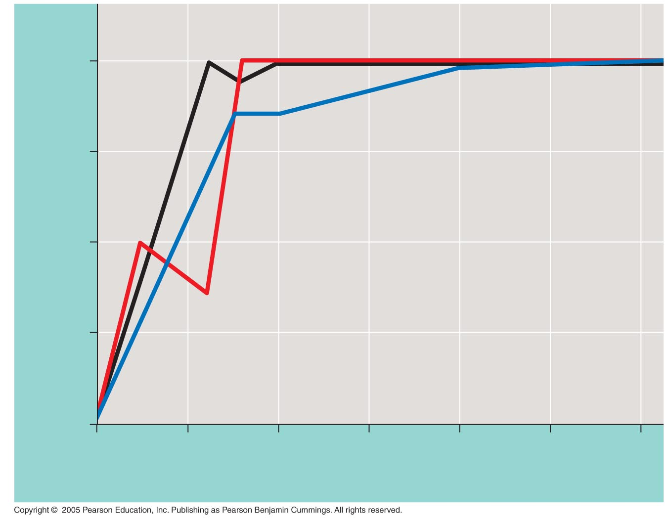
LE 22-13
100
Patient
No. 1
Patient No. 2
75
Percent of HIV resistant to 3TC
50
Patient No. 3
25
0
0
2
4
6
8
10
12
Weeks

Slide 40
Evidence of Evolution
Evolution is a theory.
As a theory, some aspects of it may be changed as new discoveries are made, but there is a large amount of evidence to support the idea in general.

Slide 41
Homology
According to the theory of evolution, if new species develop from common ancestors, they should share many physical features.
Homology is the similarity between two organisms due to common ancestry.

Slide 42
Anatomical Homologies
Homologous structures are specific parts of the anatomy that show small variations on a common design.
Example:
Human arm: Used for lifting and using tools
Cat leg – Used for walking and climbing
Whale fin – Used for swimming
Bat wing – Used for flying

Slide 43
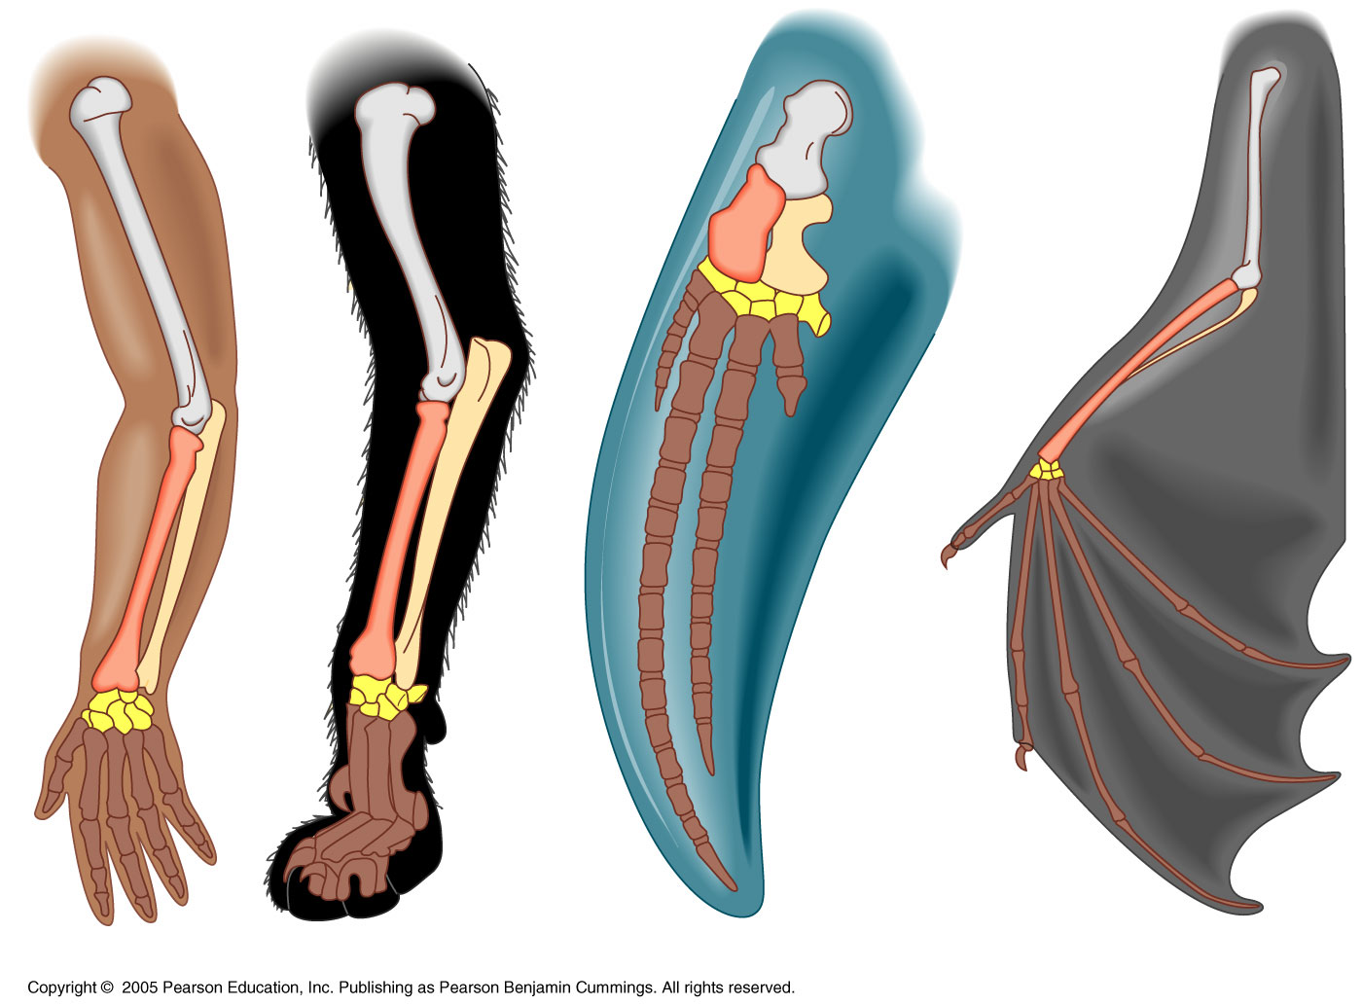
LE 22-14
Human
Cat
Whale
Bat

Slide 44
Comparative embryology is the common characteristics of two organisms in the embryo stage.

Slide 45
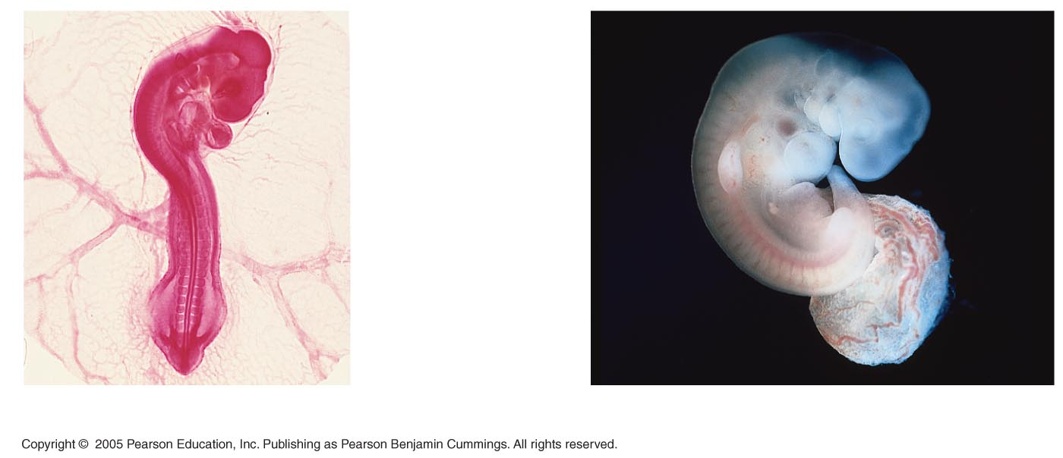
LE 22-15
Pharyngeal
pouches
(gill slits)
Tail
Chick embryo (LM)
Human embryo

Slide 46
Vestigial organs are remnants of structures that were important in the organism’s ancestors, but are no longer necessary.
In humans, examples of vestigial organs would include:
The appendix
Tailbone
Wisdom teeth

Slide 47
Molecular Homologies
Homology can also be present at the molecular level.
Sequences of DNA in chromosomes, or sequences of amino acids in proteins can be compared to see how closely related two organisms may be.

Slide 48
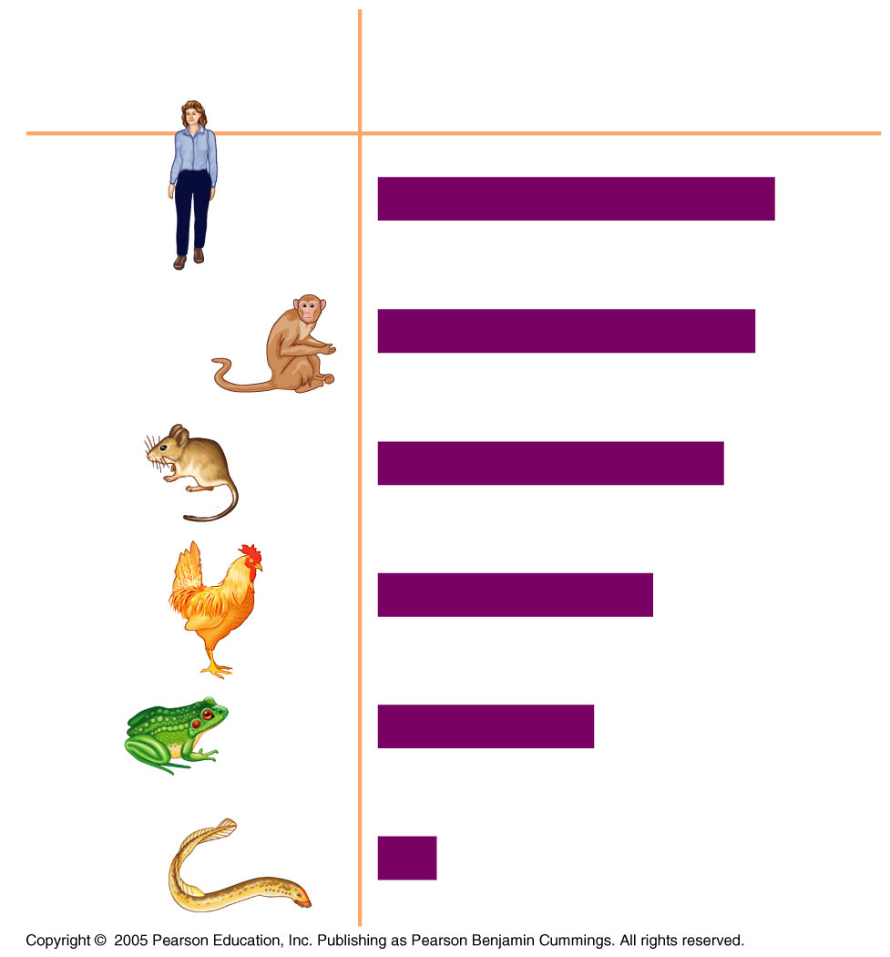
LE 22-16
Percent of Amino Acids That Are
Identical to the Amino Acids in a
Human Hemoglobin Polypeptide
Species
Human
100%
Rhesus monkey
95%
Mouse
87%
Chicken
69%
Frog
54%
Lamprey
14%

Slide 49
Convergent Evolution
Organisms that are not closely related but live in similar environments may have similar adaptations. This is called convergent evolution.
These organisms may have analogous structures, or adaptations with similar functions, but completely different structure.

Slide 50
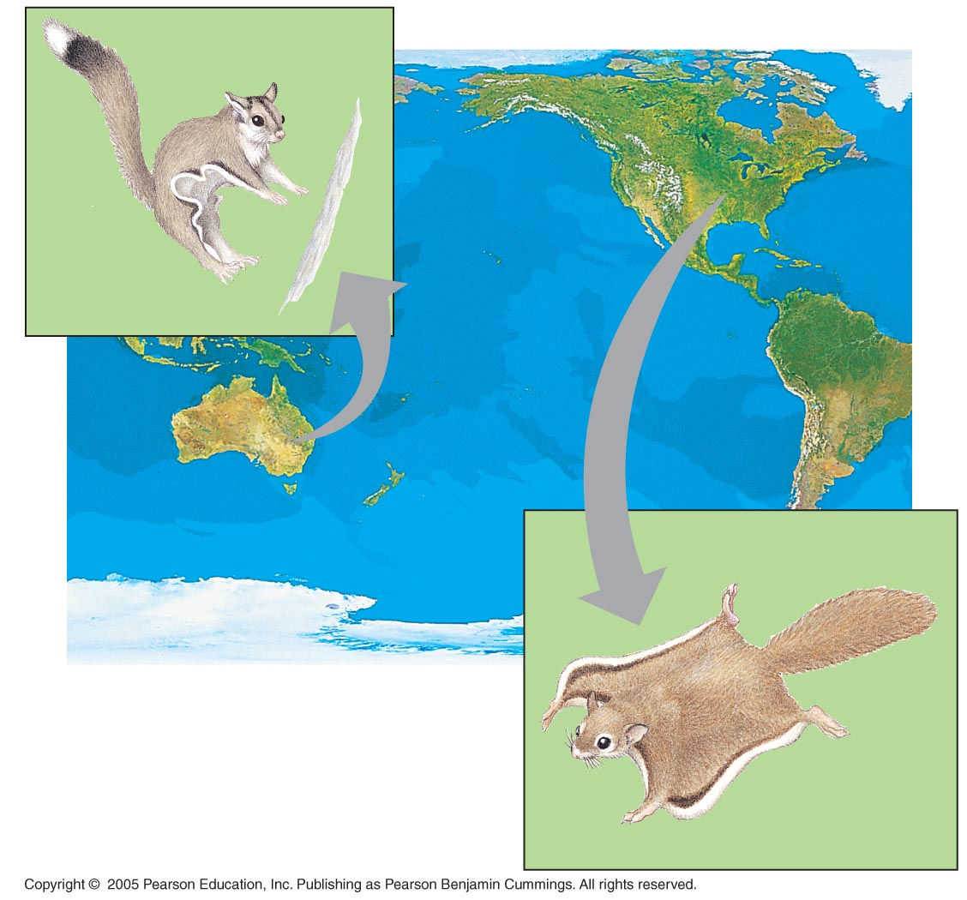
LE 22-17
NORTH
AMERICA
Sugar
glider
AUSTRALIA
Flying
squirrel

Slide 51
Biogeography
Biogeography, the geographic distribution of species, formed an important part of the theory of evolution.
Until about 200 million years ago, all the Earth’s continents were joined together in Pangaea.

Slide 52
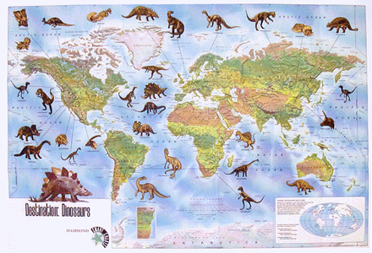
Examples of Biogeography
Dinosaurs first evolved about 250 million years ago, before Pangaea broke apart. As a result, dinosaur fossils have been found in every continent.

Slide 53
The Fossil Record
The fossil record is the most important evidence of evolution.
If two species are related, then transitional forms of species should exist. These are organisms that have characteristics of the ancient ancestor and the modern organism.
For example, if snakes and lizards are related, there should be evidence of snakes gradually losing their limbs.

Slide 54
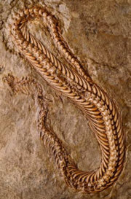
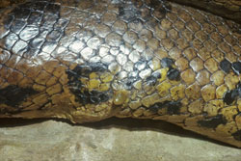
Python with tiny hind leg bones (vestigial)
95 million year-old snake fossil

Slide 55
Species
A species is defined as any two organisms who reproduce and produce fertile, healthy offspring.
One of the most important concepts in the theory of evolution is speciation, or the development of a new species from one that already exists.

Slide 56
How does Speciation Occur?
Geographic separation causes a population to be divided into two isolated groups.
A large lake can shrink into two smaller lakes. The fish in each lake are no longer able to interbreed.

Slide 57
How does Speciation Occur?
Habitat differentiation is when one group within a population begins living in a different part of the habitat.
This group will start developing adaptations to match this new part of the habitat.

Slide 58
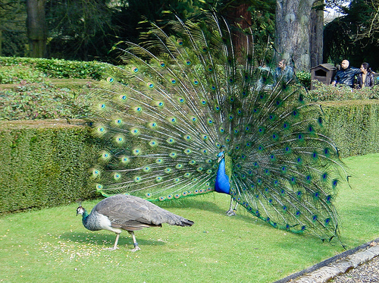
How does Speciation Occur?
Sexual selection is when females select males on the basis of their appearance, ability to fight and dominate other males, or perform specific mating rituals.
The criteria the females choose is an indirect measurement of the quality of the male’s genes.

Slide 59
A species is defined as a population of organisms that interbreed and produce healthy, fertile offspring.
Once two species are formed, why do they choose to not interbreed, or why can’t they interbreed?

Slide 60
Reproductive Isolation
Reproductive isolation any barrier that impedes two species from producing fertile, healthy offspring.
There are two types of barriers: prezygotic and postzygotic.
Prezygotic barriers prevent successful mating and fertilization.
Postzygotic barriers prevent the successful development and mating of the hybrid offspring.

Slide 61
Geographic isolation is when a physical barrier separates a population.

Slide 62
Habitat isolation is when two species live in the same general area rarely or never physically encounter each other because they occupy different habitats.
Two species of flies live in the same ecosystem, one in the soil, the other on the surface of the water.

Slide 63
Temporal isolation is when two species breed at different times of the day, different seasons of the year, or different years.

Slide 64
Behavioral isolation is when courtship calls, dances, displays, or other rituals are required before mating will occur.

Slide 65
Mechanical isolation is the genitalia of two species are physically incompatible.
Examples of unusual and unique genitalia of the animal kingdom..?

Slide 66
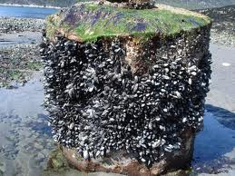
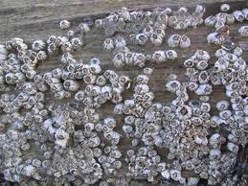
The Barnacle
The barnacle has a penis 50 times its actual body size.
This is a necessary adaptation because the barnacle is immobile; thus the length is required to actually reach their mate.

Slide 67
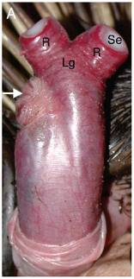
Marsupials
Most male marsupials have a forked penis with the scrotum and testes on the front.
This is a necessary adaptation because the female has a dual vagina and uterus.

Slide 68
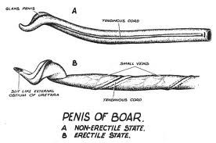
The Pig
The pig has a corkscrew-shaped penis. Female pigs have matching shaped vaginas.

Slide 69
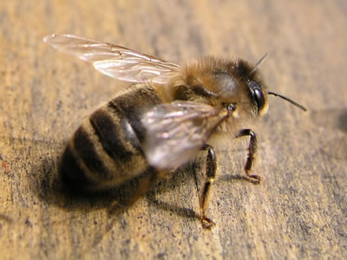
Honeybees
The genitals of the male honeybee snap off and explode once inside the queen.
In honeybee society, the queen lays the eggs while the workers are all female. The males have no other purpose except for mating.

Slide 70
Gametic Isolation
Gametic isolation is the inability of the gametes of the male and female to fuse.
The female immune system may recognize the male gametes of another species as foreign and attack them.

Slide 71
Post-Zygotic Barriers
The embryo is not able to survive to birth and is miscarried.
The offspring is born, but is not healthy or strong enough to survive to adulthood.
The offspring is born healthy but is infertile.

