Slide 1
Chemistry of Life
Introduction to Biology

Slide 2
Instructor Resources (This slide does not appear while presenting)
Aurum Science: Biology Teaching Resources
Unit Plan
Student Notes Outline
Study Guide
Written by James Dauray

Slide 3
Chemical Foundations of Biology
Biology is a multidisciplinary science
Living organisms are subject to basic laws of physics and chemistry
One example is the bombardier beetle, which uses an exothermic chemical reaction to defend itself against predators.

Slide 4
Bombardier Beetle
http://www.youtube.com/watch?v=Wl5Ch9EV0bc

Slide 5
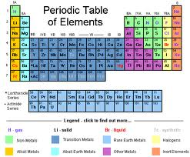
Chemistry in Biology
Organisms are composed of matter
Matter is anything that takes up space and has mass
Matter is made up of elements.

Slide 6
Elements and Compounds
An element is a substance that cannot be broken down to other substances by chemical reactions
A compound is a substance consisting of two or more elements that have chemically combined.
Compounds may have entirely different properties than the elements they are made of.
Compounds are different than mixtures, which are made of compounds or elements that are not chemically combined.

Slide 7
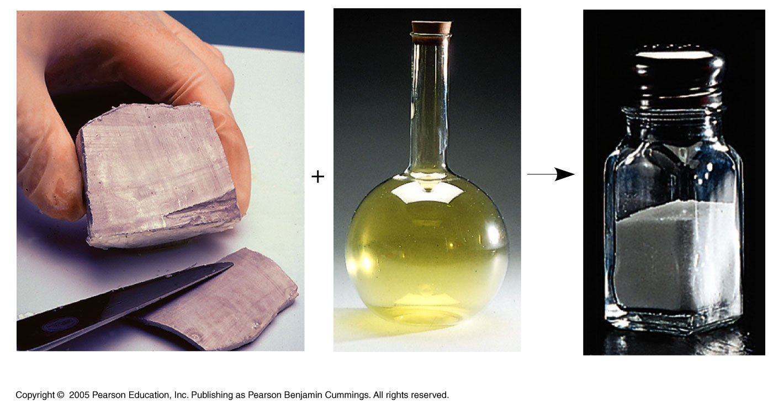
LE 2-2
Sodium
Chlorine
Sodium chloride

Slide 8
Properties
Sodium (Na) is an element.
Properties include – It is a metal, which means it is a conductor of electricity and it is malleable which means you can cut it with a knife.
Chlorine (Cl) is an element.
Properties include – It is a non-metal, toxic, corrosive, greenish-yellow gas that is irritating to the eyes and respiratory system. It has a choking smell, and inhalation causes suffocation, constriction of the chest, tightness in the throat, and—after severe exposure—edema (filling with fluid) of the lungs.
It was the first gas used in chemical warfare in World War I.
Sodium chloride (NaCl) is a compound. Its also known as halite or table salt
Physical properties include – It is a crystalline solid that is odorless and colorless or white, and it has a cubic structure. It is also soluble in water which means it dissolves and breaks down.

Slide 9
Essential Elements of Life
About 25 of the 92 elements are essential to life.
Carbon, hydrogen, oxygen, and nitrogen make up 96% of living matter.
Most of the remaining 4% consists of calcium, phosphorus, potassium, and sulfur
Trace elements are those required by an organism in minute quantities

Slide 10
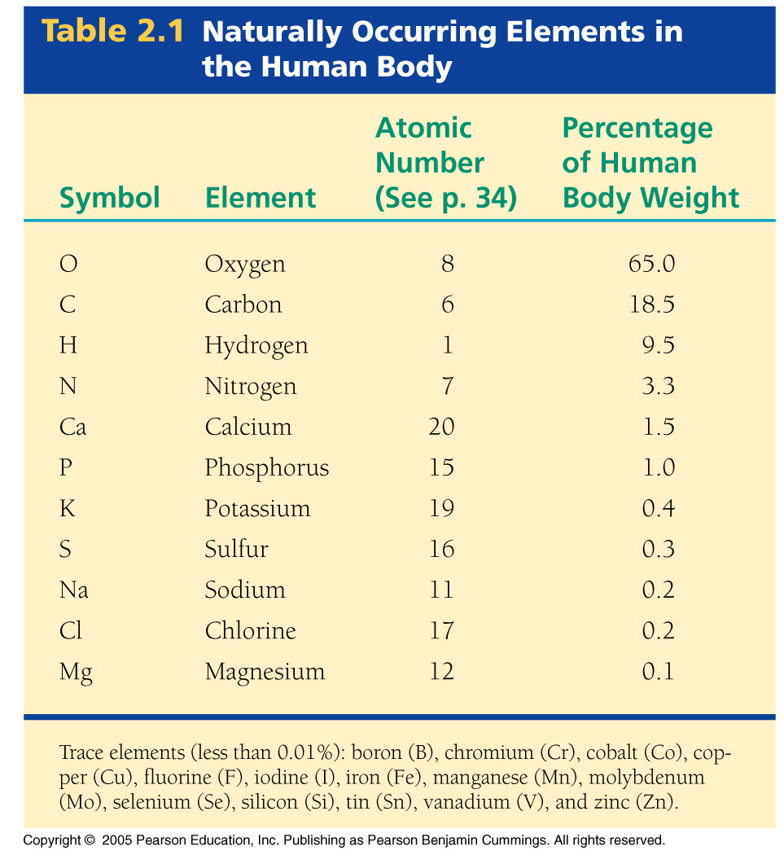

Slide 11
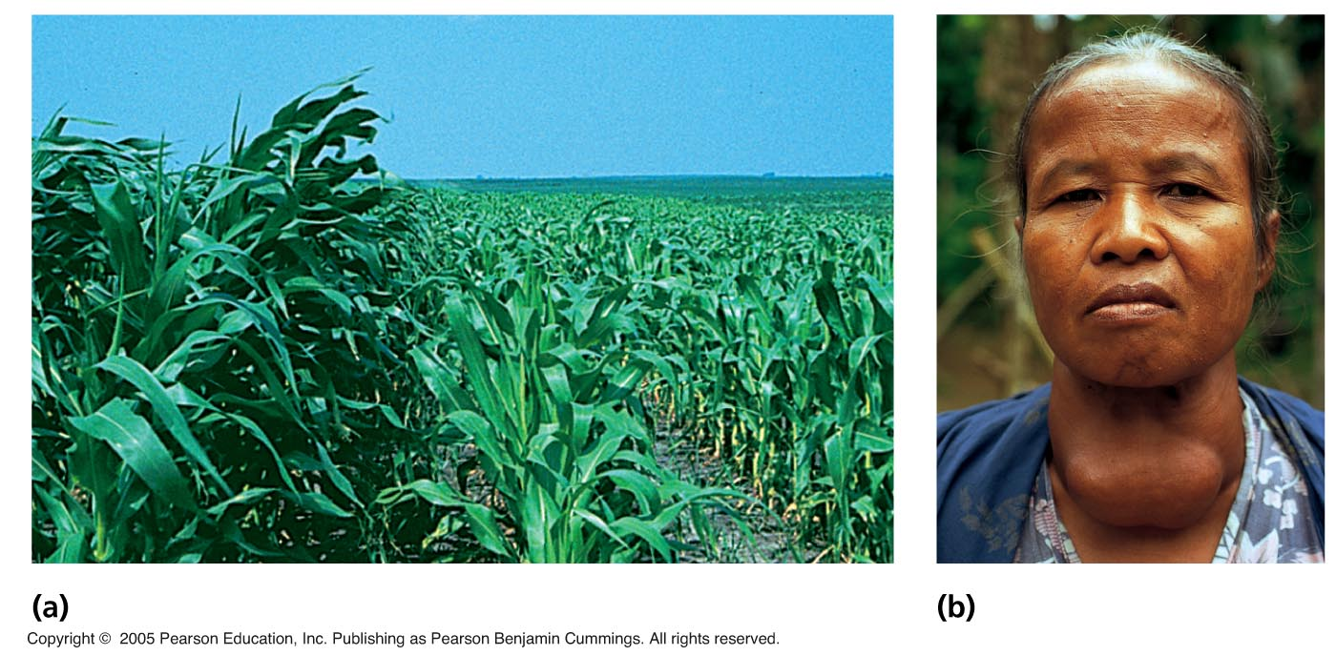
LE 2-3
(a) Nitrogen deficiency:
Leaves are pale-green to yellow, growth slows or stalls, wilts easily due to
weather conditions.
(b) Iodine deficiency:
Your thyroid gland will enlarge as it tries to increase the production of thyroid hormones.
The enlarged thyroid can cause a mass in the neck known as a goiter. As thyroid
levels fall, hypothyroidism develops.

Slide 12
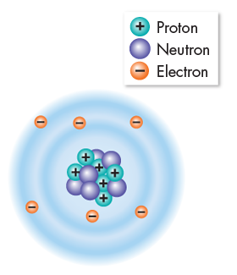
Atoms
Atoms are incredibly small.
100 million atoms laid side-by-side would only make a row one centimeter long.
About the width of your little finger!
Atoms are made of subatomic particles that are even smaller.
Protons
Neutrons
Electrons

Slide 13
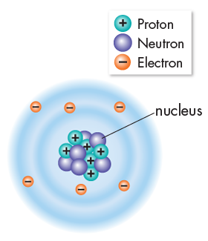
Atoms
Protons and neutrons have about the same mass.
Protons are positively charged particles (+) that determine the atom’s identity.
Neutrons are particles that carry no charge and determine the atom’s mass.
Incredibly strong forces bind protons and neutrons together to form the nucleus.

Slide 14
Atoms
Electrons are negatively charged particles (–) with only 1/1840 the mass of a proton.
Electrons are in constant motion in the space surrounding the nucleus.
Electrons determine how reactive an atom will be with other atoms.

Slide 15
Atoms
Neutral atoms have equal numbers of protons and electrons.
The positive and negative charges cancel each other out, leaving no net charge across the atom.
The carbon atom shown to the right is a neutral atom with 6 protons and 6 electrons.

Slide 16
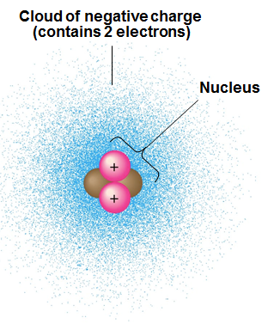
Drawing Atoms
Atoms are typically drawn in two ways.
The more accurate representation involves drawing an electron cloud.
This is considered more accurate because electrons move too quickly to pinpoint them at any specific location in the atom.

Slide 17
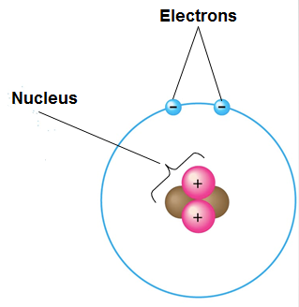
Drawing Atoms
The most commonly used way to draw atoms is to show electrons orbiting the nucleus in a circular path.
This method makes it easier to see the electrons and how they interact with other atoms during chemical reactions.

Slide 18
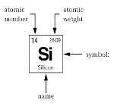
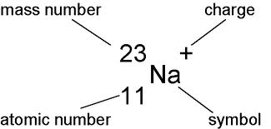
Atomic Number and Atomic Mass
Atoms of the various elements differ in number of protons, neutrons, and electrons.
An element’s atomic number is the number of protons
An element’s mass number is the sum of protons plus neutrons in the nucleus

Slide 19
Ions
Atoms that have gained or lost an electron are no longer neutral, they have a charge.
They are now called ions.
Common ions of the human body:
Na+ (sodium), found in tears, sweat, blood
K+ (potassium), found in nerve cells, blood
Ca+ (calcium), found in blood, nerve cells, muscle cells, bone
Cl- (chloride), found in blood and stomach acid

Slide 20
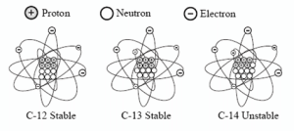
Isotopes
Atoms of an element have the same number of protons but may differ in number of neutrons
Isotopes are two atoms of an element that differ in number of neutrons
Most isotopes are stable, but some are radioactive, giving off particles and energy
Isotopes have many applications in biology.

Slide 21
Three applications for radioactive isotopes include:
Carbon-14 dating – to determine the age of items that are carbon-based
Nuclear Medicine:
To treat cancer such as with chemotherapy
To identify medical conditions such as tumors

Slide 22
Carbon-14 Dating
The most common and stable isotope of carbon is Carbon-12, but it also exists as carbon-13 and 14.
Carbon-14 is a radioactive isotope. Radioactive substances are unstable and break down over time.
The half-life of an isotope is the amount of time it takes for half of a sample to decay.
All living things contain some carbon-12 and some carbon-14 in their cells.
The half-life of carbon-14 is 5,700 years. This value can be used to determine the approximate age of a fossil.

Slide 23
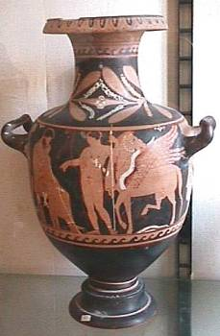
Carbon Dating Example
An archeologist discovers a piece of pottery.
Inside that pottery are seeds. Chemical analysis reveals the seeds only have about 12% of the original carbon-14 remaining. How old is the pottery?

Slide 24
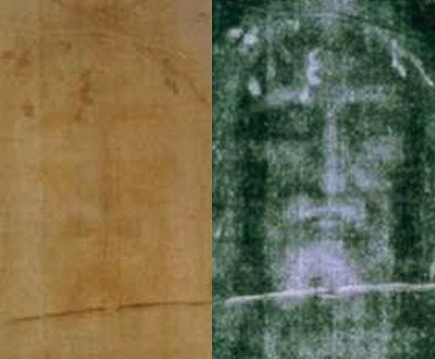
Application of Carbon-14 Dating: Shroud of Turin

Slide 25
Shroud of Turin Carbon-14 Dating Study
A small sample was cut from the shroud and divided into three pieces.
Each piece was given to a different lab.
Three older ancient cloth samples were also sampled and included.
None of the samples were labeled, to prevent bias.
Results:
Date range of shroud is 1262-1385 A.D.
Inconclusive? The shroud had been in a fire and parts were burned and repaired -- sample may have been taken from a repaired area

Slide 26
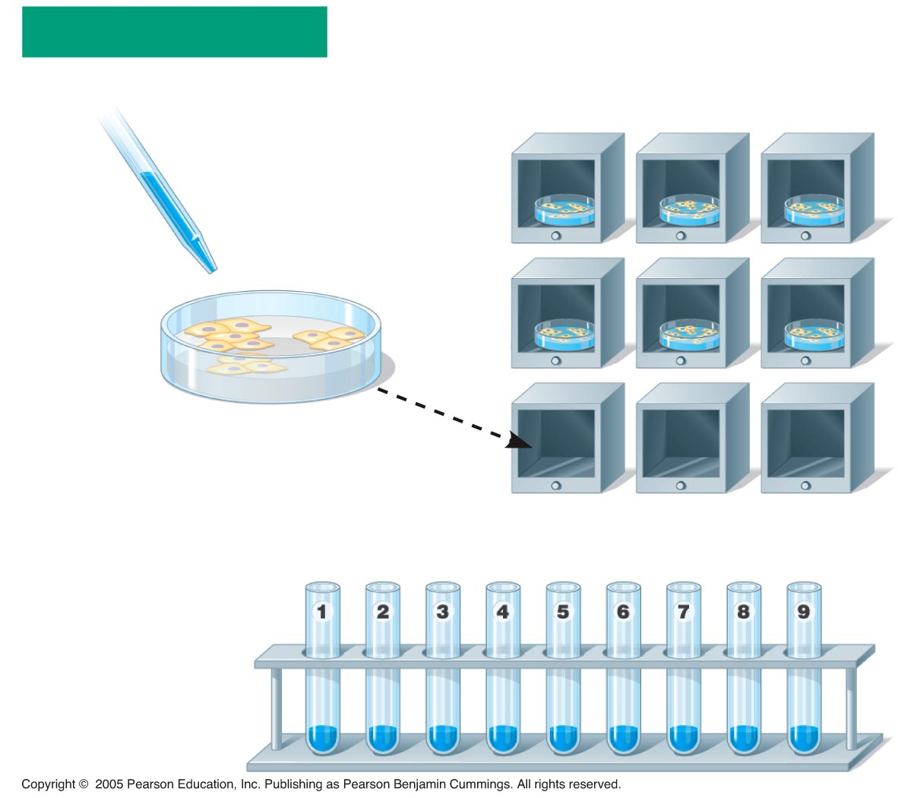
Radioactive Tracer Isotopes
Radioactive isotopes can be used to treat cancer, such as chemotherapy.
The radioactive isotopes can be added to cells. The cells will incorporate these isotopes into their DNA and proteins.
One experiment took these cells and incubated them at nine different temperatures to see if DNA had an optimal range of temperature to duplicate.

Slide 27
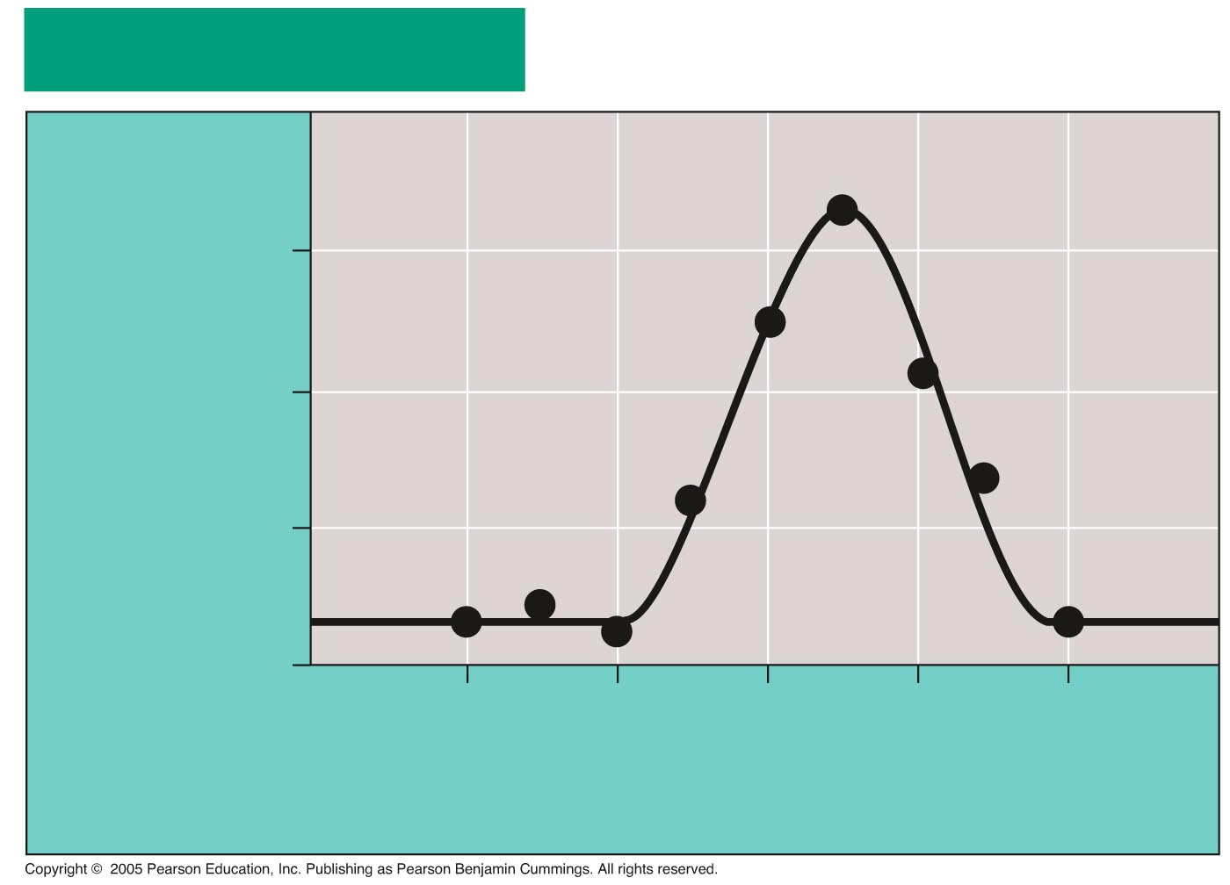
LE 2-5c
RESULTS
Optimum
temperature
for DNA
synthesis
30
Counts per minute
(x 1,000)
20
10
0
10
20
30
40
50
Temperature (°C)

Slide 28
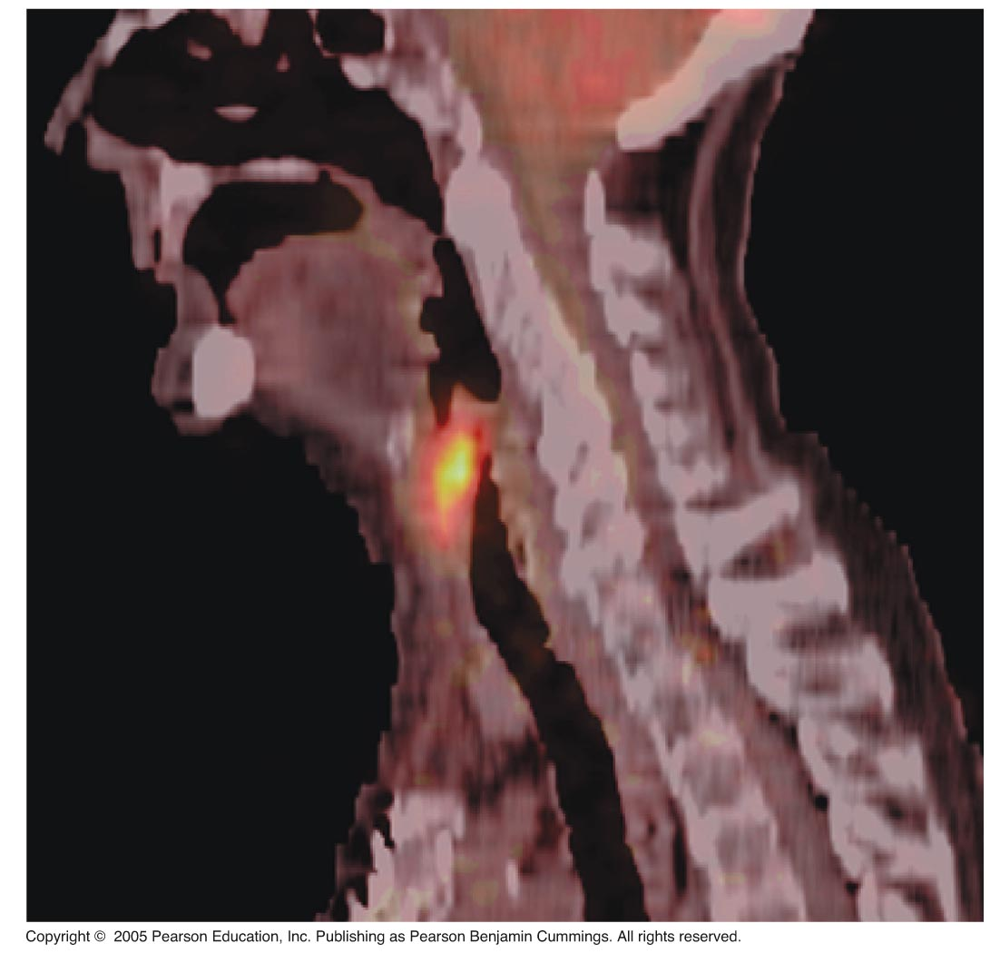
Radioactive Tracer Isotopes
Tracer isotopes are placed in dyes that are ingested or injected into the body. Medical tests can “trace” the location of the dye to identify tumors, which contain cells that divide their DNA much faster than usual.

Slide 29
Chemical Bonds
Elements can combine to form compounds.
The elements are held together by chemical bonds.
A covalent bond is the sharing of a pair of valence electrons by two atoms.
An ionic bond occurs when one atom takes another atom’s electrons.

Slide 30
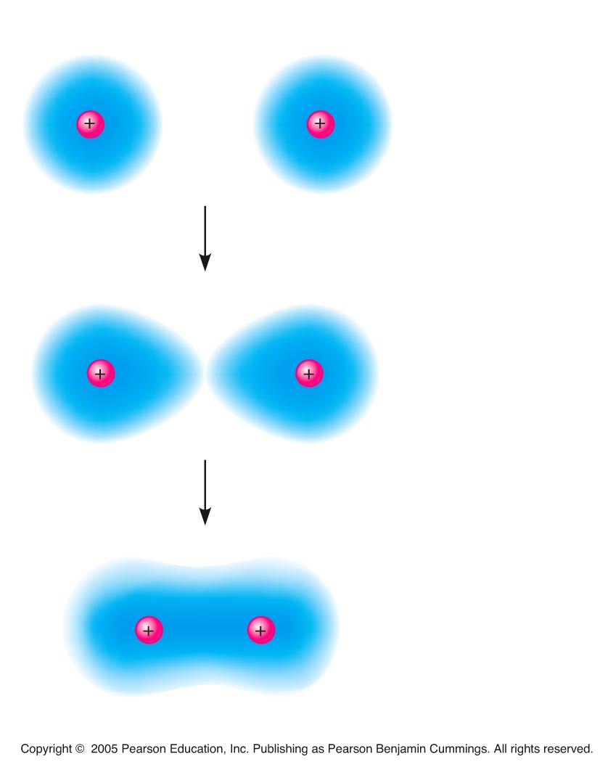
LE 2-10
Hydrogen atoms (2 H)
Covalent bond between two
hydrogen atoms to
form hydrogen gas
Hydrogen
molecule (H₂)

Slide 31
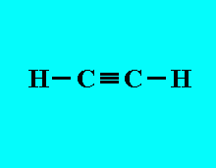
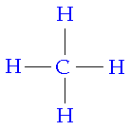
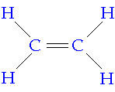
Types of Covalent Bonds
A single bond, is the sharing of one pair of valence electrons.
A double bond, is the sharing of two pairs of valence electrons.
A triple bond, is the sharing of three pairs of valence electrons.

Slide 32
How to Display Covalent Bonds

Slide 33
Covalent Bonds Example: Oxygen Gas (O₂)
Name
(molecular
formula)
Electron-
shell
diagram
Structural
formula
Space-
filling
model
Oxygen (O₂)

Slide 34
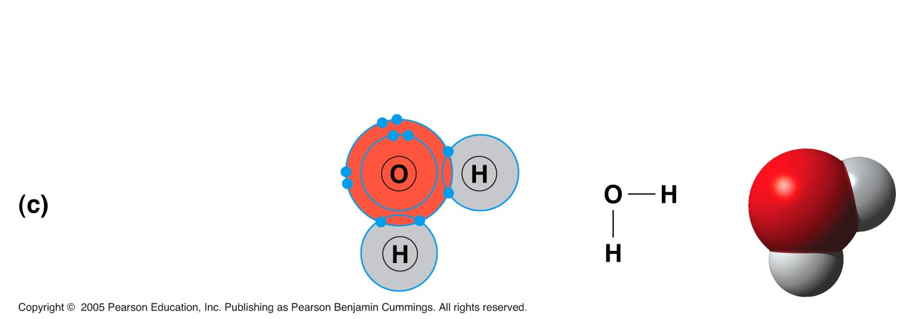
Covalent Bonds Example: Water (H₂O)
Name
(molecular
formula)
Electron-
shell
diagram
Structural
formula
Space-
filling
model
Water (H₂O)

Slide 35
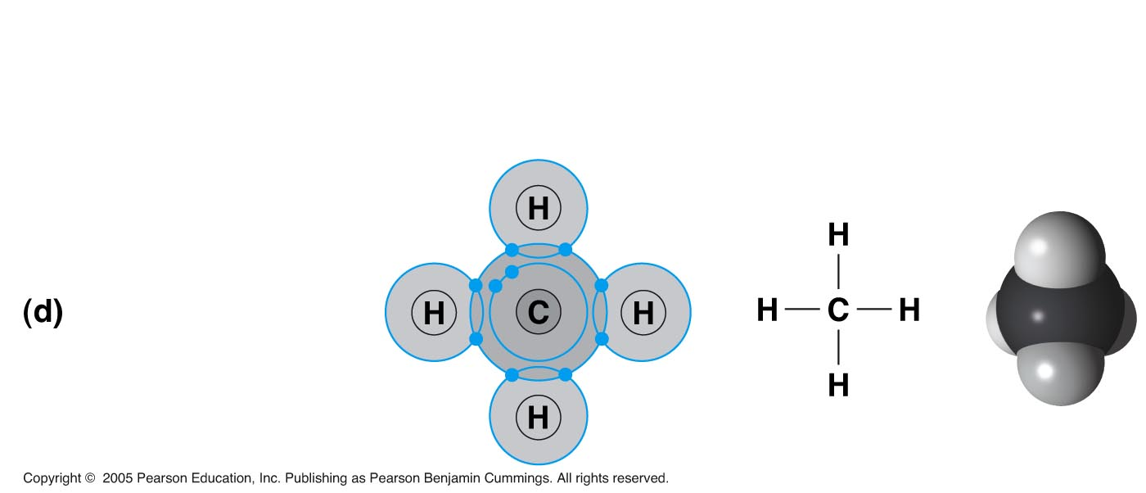
Covalent Bonds Example: Methane (CH₄)
Name
(molecular
formula)
Electron-
shell
diagram
Structural
formula
Space-
filling
model
Methane (CH₄)

Slide 36
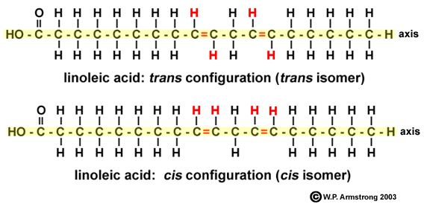
Energy In Chemical Bonds
Energy is the capacity to cause change.
Every chemical bond has an amount of potential energy that can be released.
Potential energy is the energy that matter has because of its location or structure
Example of location: Top of Rollercoaster
Example of structure: A molecule of fat

Slide 37
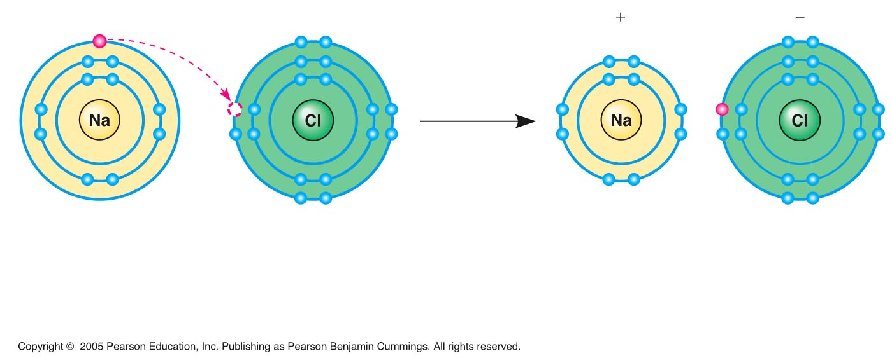
Ionic Bonds
Some atoms can take electrons away from other atoms.
For example, an electron transfers from sodium to chlorine.
After the transfer, both atoms have charges.
A charged atom (or molecule) is called an ion
Na
Cl
Na⁺
Cl–
Sodium atom
(an uncharged
atom)
Chlorine atom
(an uncharged
atom)
Sodium ion
(a cation)
Chlorine ion
(an anion)
Sodium chloride (NaCl)

Slide 38
Ionic Bonds
Ions with opposite charges will attract each other.
The attraction formed is called an ionic bond.
Compounds formed by ionic bonds are called ionic compounds, or salts
Salts, such as sodium chloride (table salt), are often found in nature as crystals
Na
Cl
Na⁺
Cl–

Slide 39
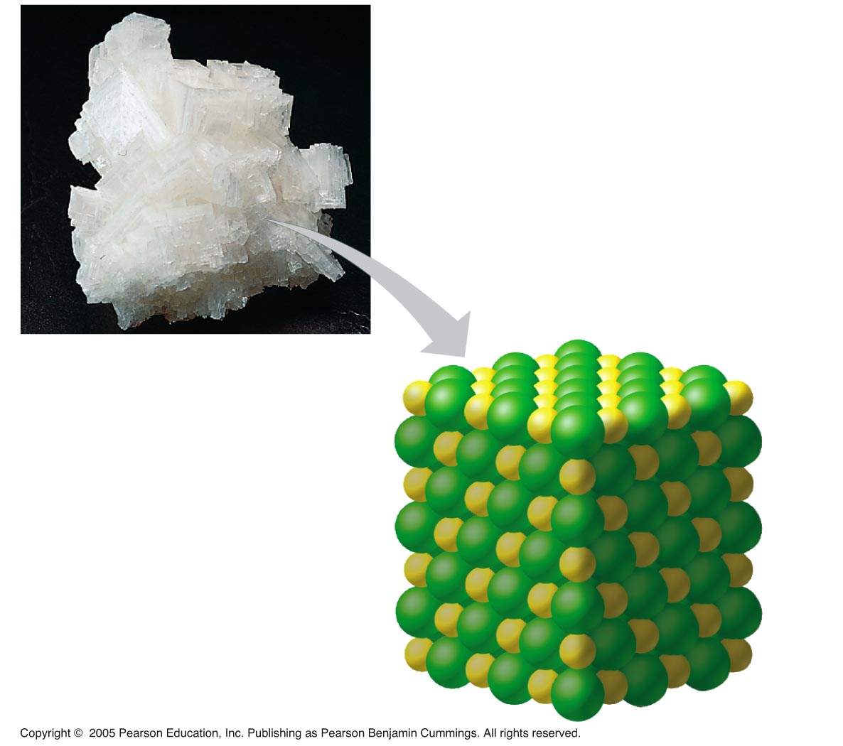
LE 2-14
A single crystal of table salt (NaCl) shown microscopically.
Na⁺
Cl–

Slide 40
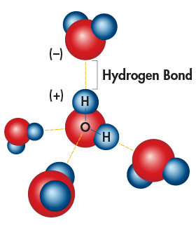
Hydrogen Bonds
Polar covalent compounds, like water, can form hydrogen bonds.
A hydrogen bond occurs when two compounds that contain charged areas attract each other.
All of water’s unusual properties are due to hydrogen bonding.

Slide 41
Water Properties
Cohesion is the attraction between molecules of water.
Causes water to form beads or droplets.
Creates the effect of surface tension.

Slide 42
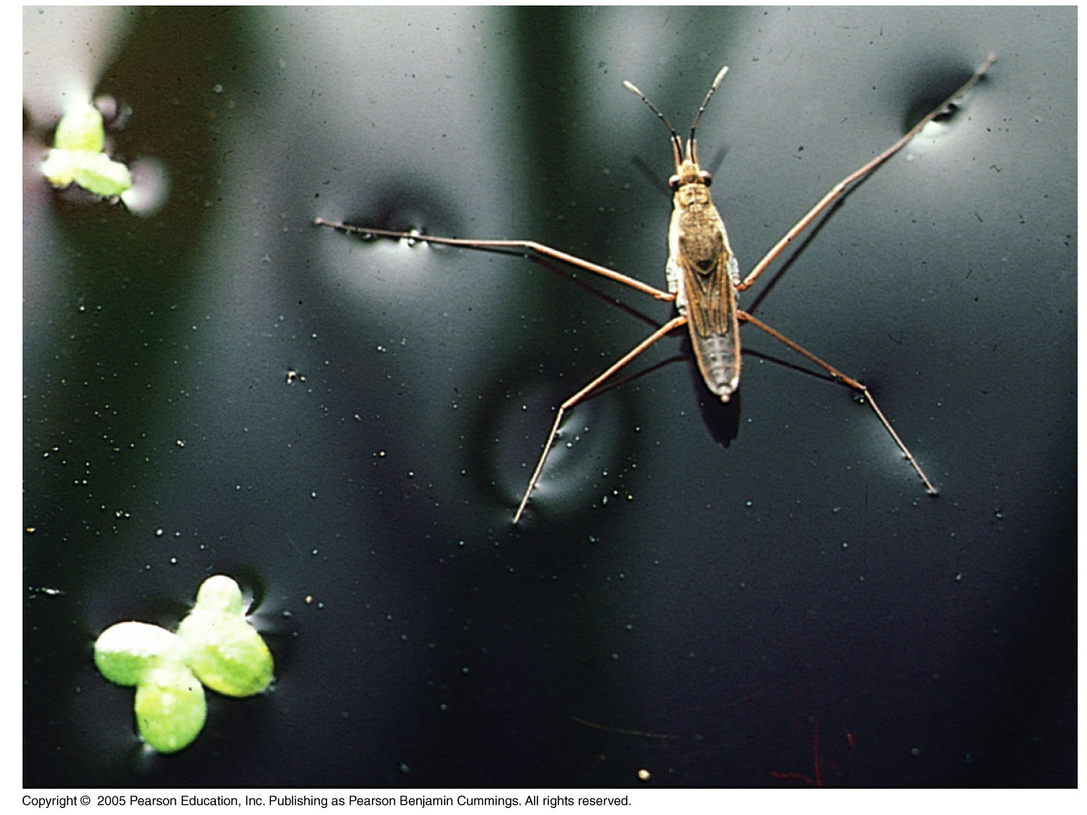

Slide 43
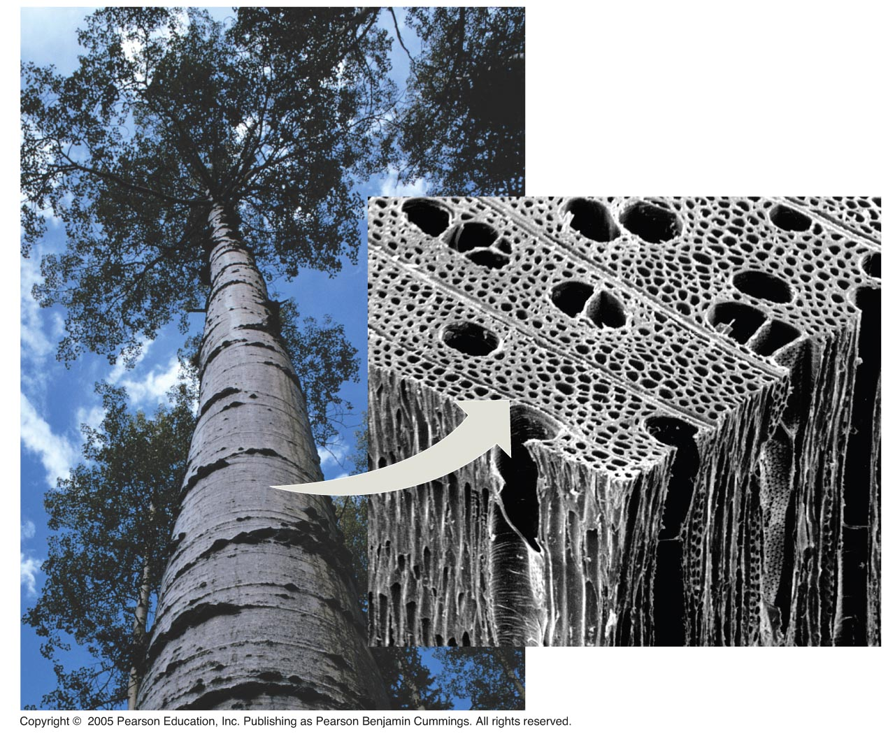
Water Properties
Adhesion is the attraction of water to the molecules of the container or tube it is in.
Helps plants transport water up their stems.
Water-conducting cells

Slide 44
Water Properties
Water has a very high heat capacity
A large amount of heat energy is required to raise the temperature of water.
Lake Michigan daytime surface water temperature in summer: 68-76°F
Chicago area average daytime air temperature in July: 84°F

Slide 45
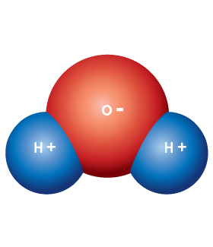
Polarity
Water is considered a polar molecule.
It has a positive and negative end.
The oxygen end of the water molecule has a slight negative charge.
The hydrogen end of the water molecule has a slight positive charge.

Slide 46
Water Properties
Water is known as the universal solvent.
Because water is polar, it can dissolve many different solutes.
Salts, sugars, etc.
When something is dissolved completely in water, it is called a solution.

Slide 47
Acids, Bases, and pH
A few (1 in 550 million) water molecules spontaneously split into ions.
Pure water has equal amounts of H+ and OH- ions. This is considered neutral.
Acids have higher amounts of H+ ions.
Bases have higher amounts of OH- ions.

Slide 48
The pH scale
Solutions with a pH level below 7 are acidic.
Solutions with a pH level above 7 are basic.
Solutions with a pH level of 7 are neutral.

Slide 49
Human body pH levels
Blood requires a pH of 6.8-7.0 to maintain homeostasis.
Sweat has a pH between 4.0-6.8 (defense against bacteria)
Saliva pH is normally around 6.0 (digestion)

Slide 50
Buffers
Blood and other body fluids contain buffers, which can “absorb” increases on H+ (acid) or OH- (base) ions.
This prevents sudden changes in body pH, which would be deadly.

Slide 51
Chemical Bonds - Van der Waals Interactions
Molecules or atoms that are very close together can have very weak magnetic attractions.
These weak attractions are called Van der Waals interactions
Collectively, such interactions can be strong.
Example: The ability of Geckos to climb vertical surfaces.

Slide 52
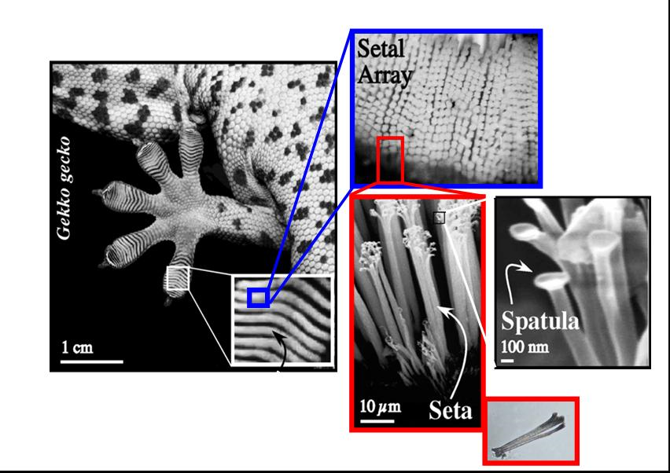
Van der Waals Interactions

Slide 53
Chemical Bond Strength
Covalent bonds are usually the strongest in an organism.
Ionic bonds and hydrogen bonds are weaker.
Van der Waals forces are the weakest bonds.
The atoms and molecules found within living organisms will have combinations of all four of these chemical bonds.
The specific combination of bonds in a molecule gives it a specific shape.

Slide 54
Molecular Shape and Function
The function of a molecule of a living organism is completely dependent on its shape.
Biological molecules recognize and interact with each other with a specificity based on their molecular shapes.
Molecules with similar shapes can have similar biological effects
Endorphins are chemicals produced by the brain that produce a sense of euphoria.
Morphine is a drug that can have similar effects.

Slide 55
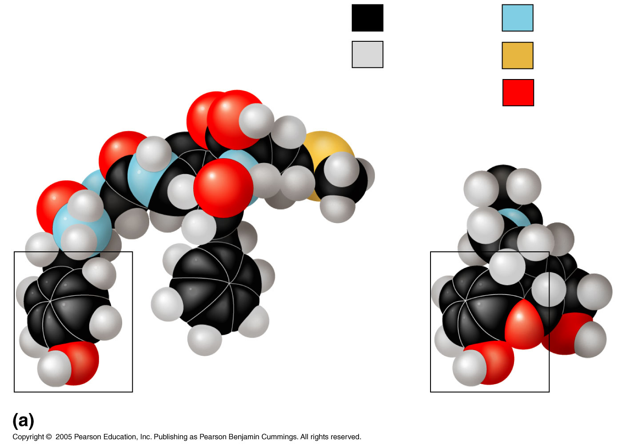
Carbon
Nitrogen
Hydrogen
Sulfur
Natural
endorphin
Oxygen
Morphine
Structures of endorphin and morphine

