Slide 1
The Plasma Membrane
Fluid Dynamics and Cell Transportation

Slide 2
Instructor Resources This slide does not appear while presenting
Textbooks used as reference:
Biology, Eighth edition by Campbell
Prentice Hall Biology by Miller and Levine
Fillable student notes outline:
http://www.aurumscience.com/biology/5_transport/notes_outline.html
Other worksheets and assignments:
http://www.aurumscience.com/biology/5_transport/index.html
Next Unit: Photosynthesis
http://www.aurumscience.com/biology/6_photosynthesis/index.html
Written by James Dauray

Slide 3
The Plasma Membrane
The plasma membrane is the boundary that separates the living cell from its nonliving surroundings
The plasma membrane exhibits selective permeability, meaning some substances can go through, others cannot.

Slide 4
Fluid Mosaic Model
The plasma membrane is primarily made of phospholipids.
Phospholipids contain both hydrophobic (water-hating) and hydrophilic (water-loving) regions
The fluid mosaic model states that a membrane is constantly moving with a mixture of proteins embedded in it

Slide 5
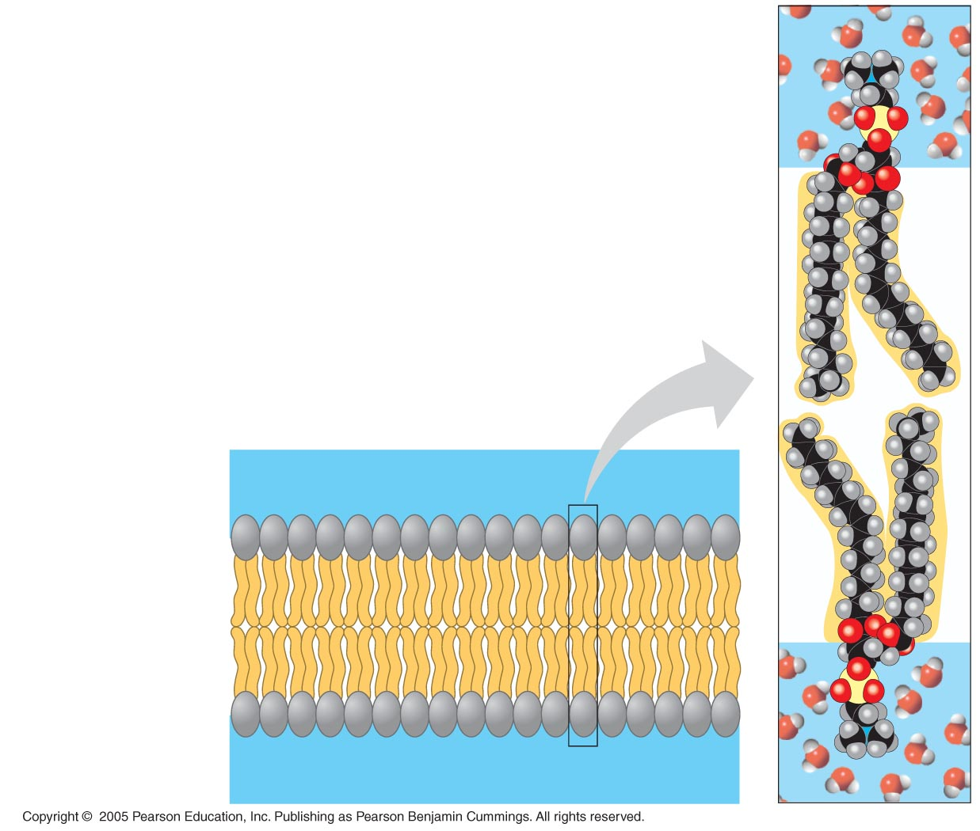
LE 7-2
WATER
Hydrophilic
head
Hydrophobic
tail
WATER

Slide 6
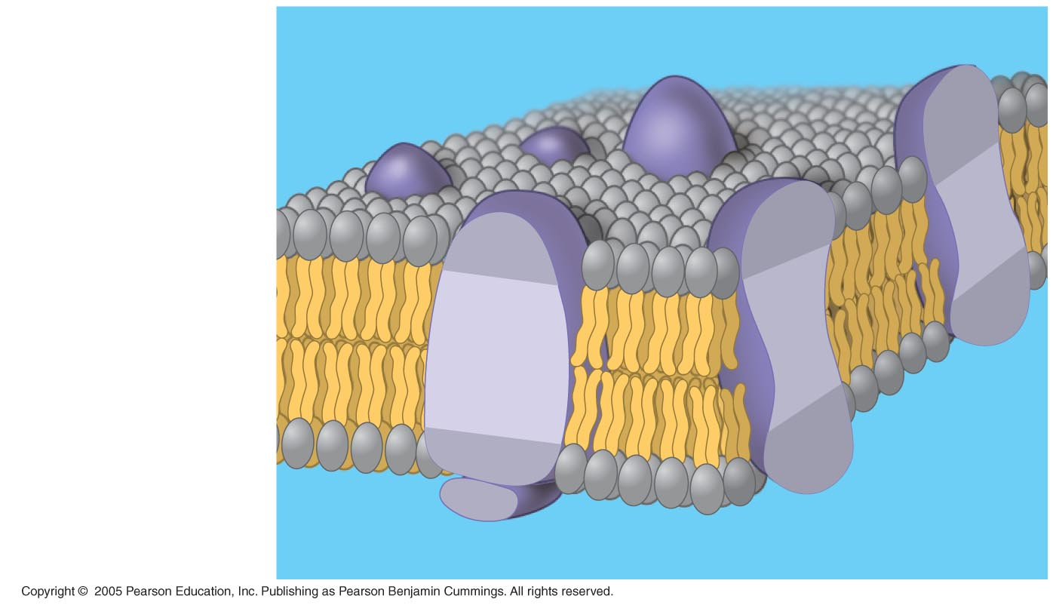
LE 7-3
Hydrophilic region
of protein
Phospholipid
bilayer
Hydrophobic region of protein

Slide 7
As temperatures cool, membranes switch from a fluid state to a solid state
Membranes must be fluid to work properly; they are usually about as fluid as vegetable oil.
Membranes are fluid because they contain a high number of unsaturated fatty acids.

Slide 8
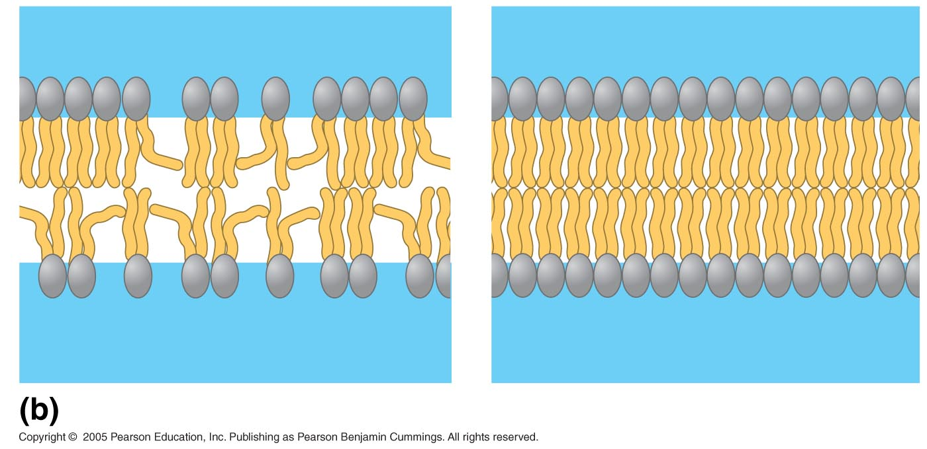
LE 7-5b
Fluid
Viscous (Thick)
Unsaturated hydrocarbon
tails with kinks
Saturated hydro-
carbon tails

Slide 9
Cholesterol helps to maintain the homeostasis of membranes, keeping them fluid.
At warm temperatures, cholesterol keeps phospholipids from moving around too much.
At cool temperatures, it maintains fluidity by preventing tight packing

Slide 10
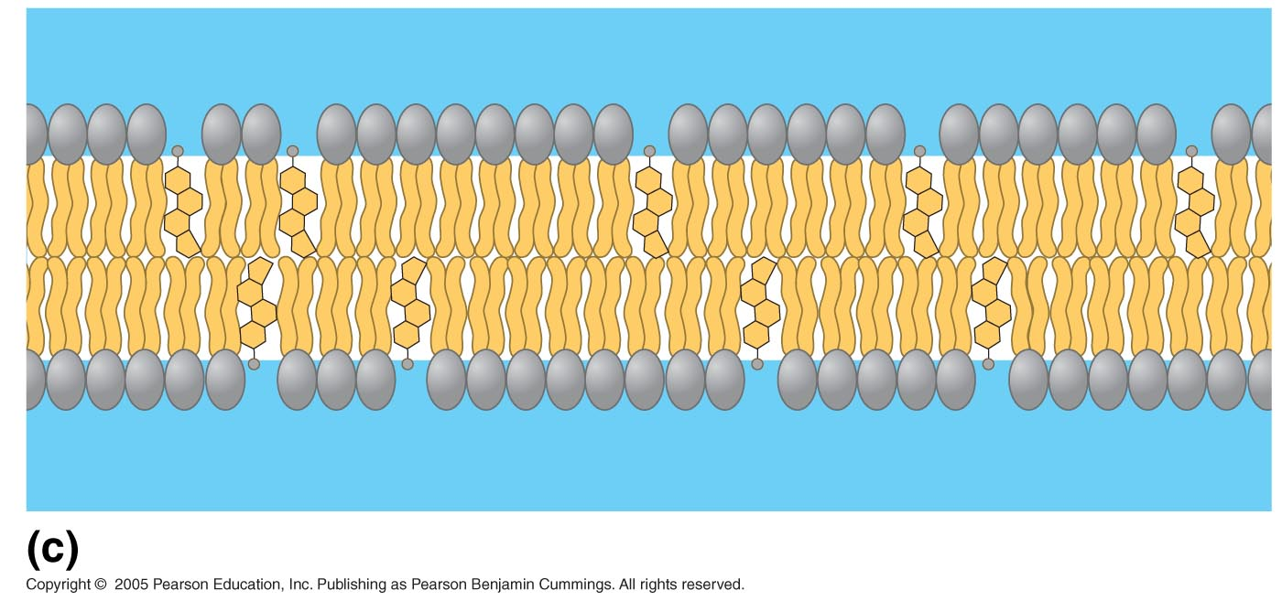
LE 7-5c
Cholesterol
Cholesterol within the animal cell membrane

Slide 11
Membrane Proteins and Their Functions
Proteins determine most of the membrane’s specific functions
Peripheral proteins are on the surface of the membrane, either outside or inside the cell.
Integral proteins go all the way through the phospholipid bilayer and contact both sides.

Slide 12
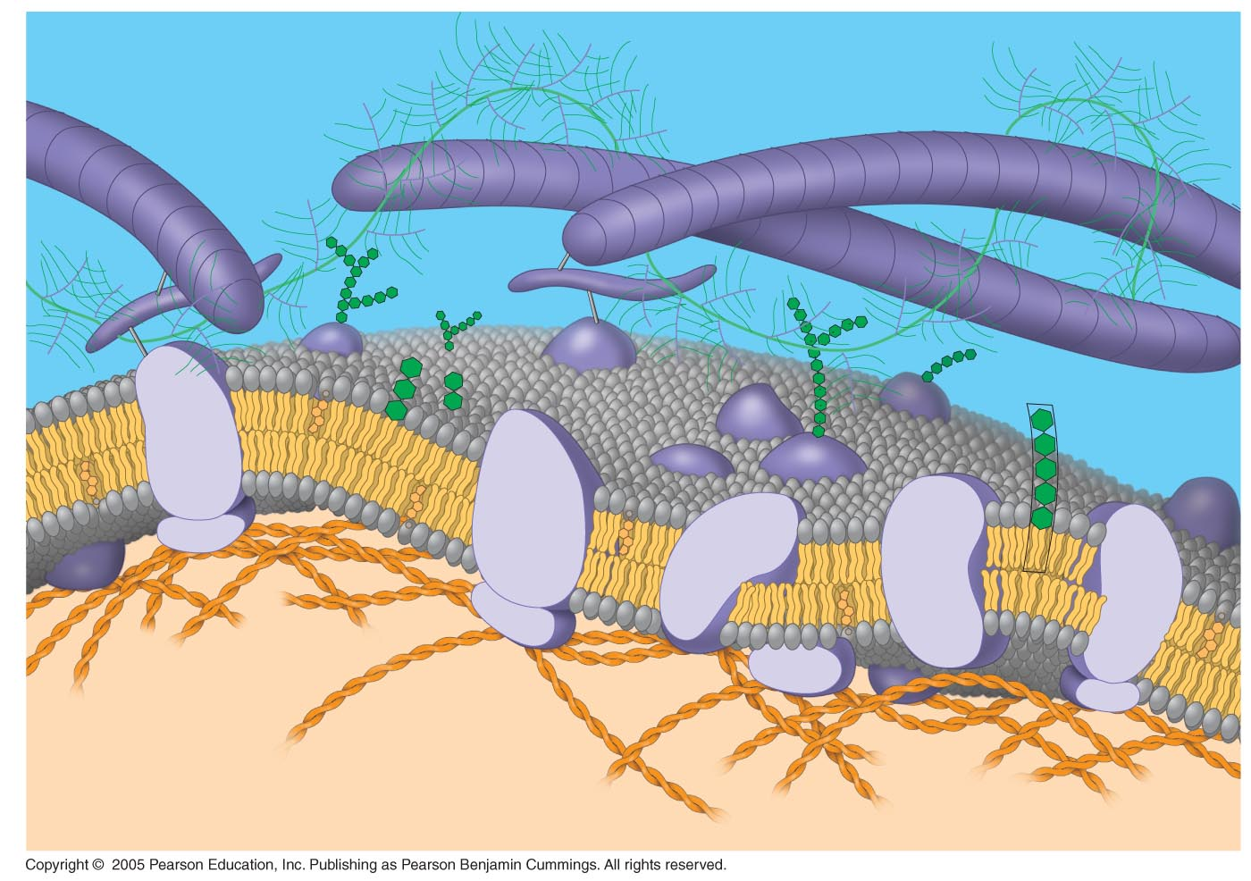
LE 7-7
Fibers of
extracellular
matrix (ECM)
Glycoprotein
Carbohydrate
Glycolipid
EXTRACELLULAR
SIDE OF
MEMBRANE
Cholesterol
Microfilaments
of cytoskeleton
Peripheral
proteins
Integral
protein
CYTOPLASMIC SIDE
OF MEMBRANE

Slide 13
Membrane Proteins and Their Functions
Six major functions of membrane proteins:
Transport substances across the cell membrane
Serve as enzymes for reactions
Transmit signals across the cell membrane
Cell-cell recognition
Joining of two cells together
Attachment to the cytoskeleton

Slide 14
Membrane Carbohydrates
Cells can recognize each other by binding to carbohydrates on the plasma membrane.
These carbohydrates vary among species, individuals, and even cell types in an individual.
This is how the immune system recognizes “self” and “foreign” cells.
Example: Blood type (A, B, AB, O) is determined by markers on your red blood cell membranes.

Slide 15
Permeability of the Lipid Bilayer
The cell membrane is selectively permeable.
Nonpolar (hydrophobic) molecules can dissolve in the lipid bilayer and pass through the membrane rapidly
Examples: Oxygen, carbon dioxide, hormones made of lipids
Large polar (hydrophilic) molecules, cannot cross the membrane as easily.
Examples: Glucose, sucrose, proteins

Slide 16
Transport Proteins
Transport proteins are needed to allow passage of polar substances across the membrane
Channel proteins, act like a tunnel that ions or other molecules can use to enter the cell.
Example: Aquaporins facilitate the passage of water.
Carrier proteins, bind to molecules and change shape to shuttle them across the membrane
A transport protein is specific for one substance only.

Slide 17
Passive Transport
Diffusion is the movement of molecules areas of greater concentration to areas of lower concentration.
This is considered passive transport because no energy is required.

Slide 18
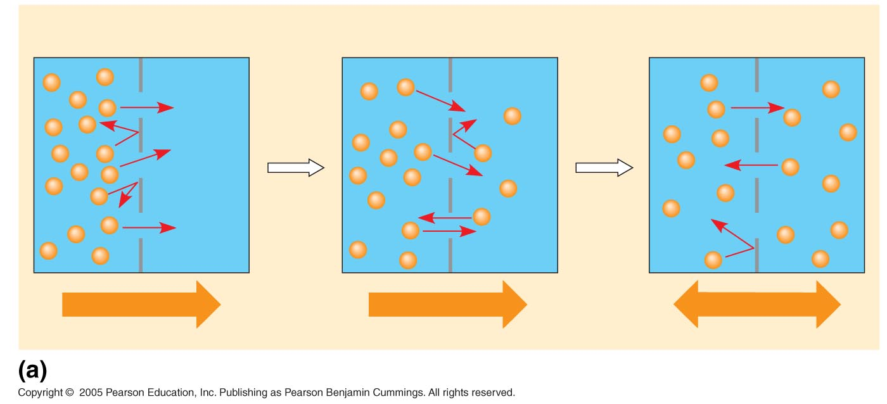
LE 7-11a
Molecules of dye
Membrane (cross section)
WATER
Net diffusion
Net diffusion
Equilibrium
Diffusion of one solute

Slide 19
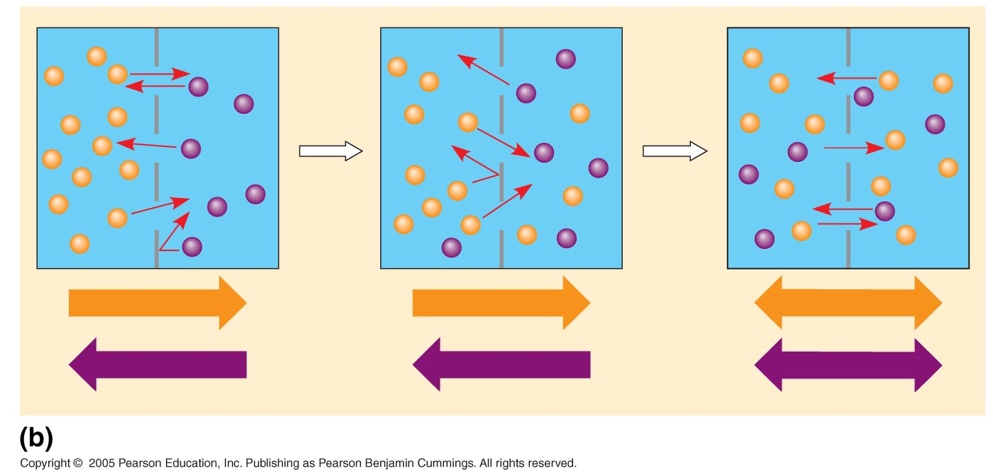
LE 7-11b
Net diffusion
Net diffusion
Equilibrium
Net diffusion
Net diffusion
Equilibrium
Diffusion of two solutes

Slide 20
Osmosis and Water Balance
Osmosis is the diffusion of water across a selectively permeable membrane
The direction of osmosis is determined only by a difference in the concentration of solutes.
Solutes are substances dissolved in water, like sugar or salts.
Water diffuses across a membrane from the region of lower solute concentration to the region of higher solute concentration

Slide 21
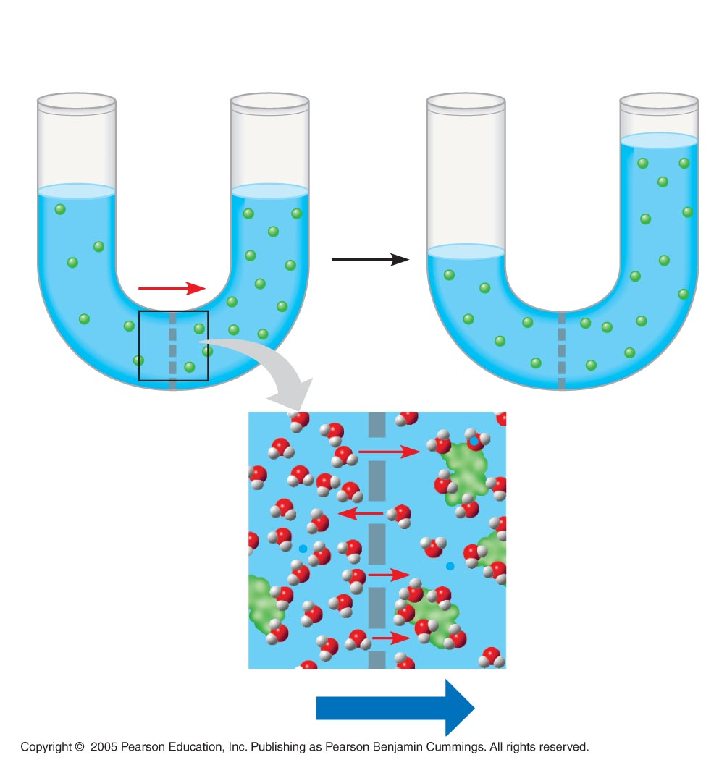
LE 7-12
Lower
concentration
of solute (sugar)
Higher
concentration
of sugar
Same concentration
of sugar
H₂O
sugar molecules
cannot pass
through pores, but
water molecules can
Osmosis

Slide 22
Water Balance of Cells Without Walls
These are the three types of solutions that cells can be placed in:
Isotonic solution: concentration of solutes (sugars, salts) is the same as that inside the cell
cell does not change
Hypertonic solution: concentration of solutes is greater outside the cell
cell loses water and shrivels up
Hypotonic solution: concentration of solutes is lower than that inside the cell
cell gains water and bursts

Slide 23
Effect of Tonicity on Animal and Plant Cells
Can you predict what will happen when a red blood cell is exposed to different types of solutions?

Slide 24
LE 7-13
Distilled water
Isotonic solution
Saltwater
Animal
cell
H₂O
?
H₂O
Lysed
Shriveled
Plant
cell
H₂O
H₂O
H₂O
H₂O
Turgid (normal)
Flaccid
Plasmolyzed

Slide 25
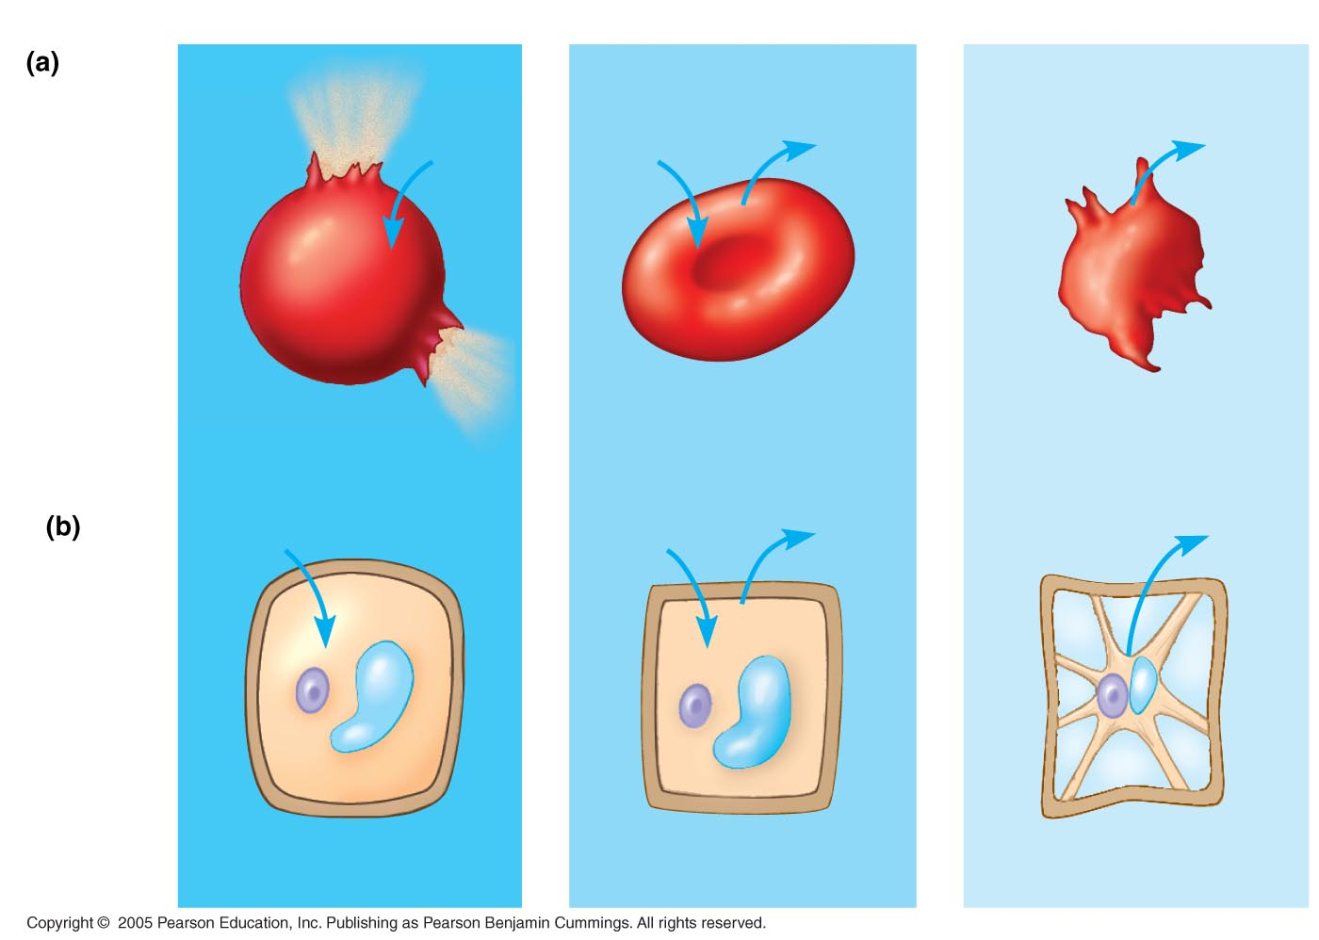
LE 7-13
Distilled water
Isotonic solution
Salt water
Animal
cell
H₂O
H₂O
H₂O
H₂O
?
Lysed
Normal
Shriveled
Plant
cell
H₂O
H₂O
H₂O
H₂O
Turgid (normal)
Flaccid
Plasmolyzed

Slide 26
LE 7-13
Distilled water
Isotonic solution
Saltwater
Animal
cell
H₂O
H₂O
H₂O
H₂O
?
Lysed
Normal
Shriveled
Plant
cell
H₂O
H₂O
H₂O
H₂O
Turgid (normal)
Flaccid
Plasmolyzed

Slide 27
LE 7-13
Distilled water
Isotonic solution
Salt water
Animal
cell
H₂O
H₂O
H₂O
H₂O
Lysed
Normal
Shriveled
Plant
cell
H₂O
H₂O
H₂O
H₂O
?
?
?
Turgid (normal)
Flaccid
Plasmolyzed

Slide 28
Animal cells cannot survive in a hypertonic or hypotonic environment because their cell membranes are too thin.
Some organisms have adaptations to allow them to survive in these environments.
Example: The protist Paramecium lives in a hypotonic environment.
It has vacuole that can absorb excess water and pump it back out of the cell.

Slide 29
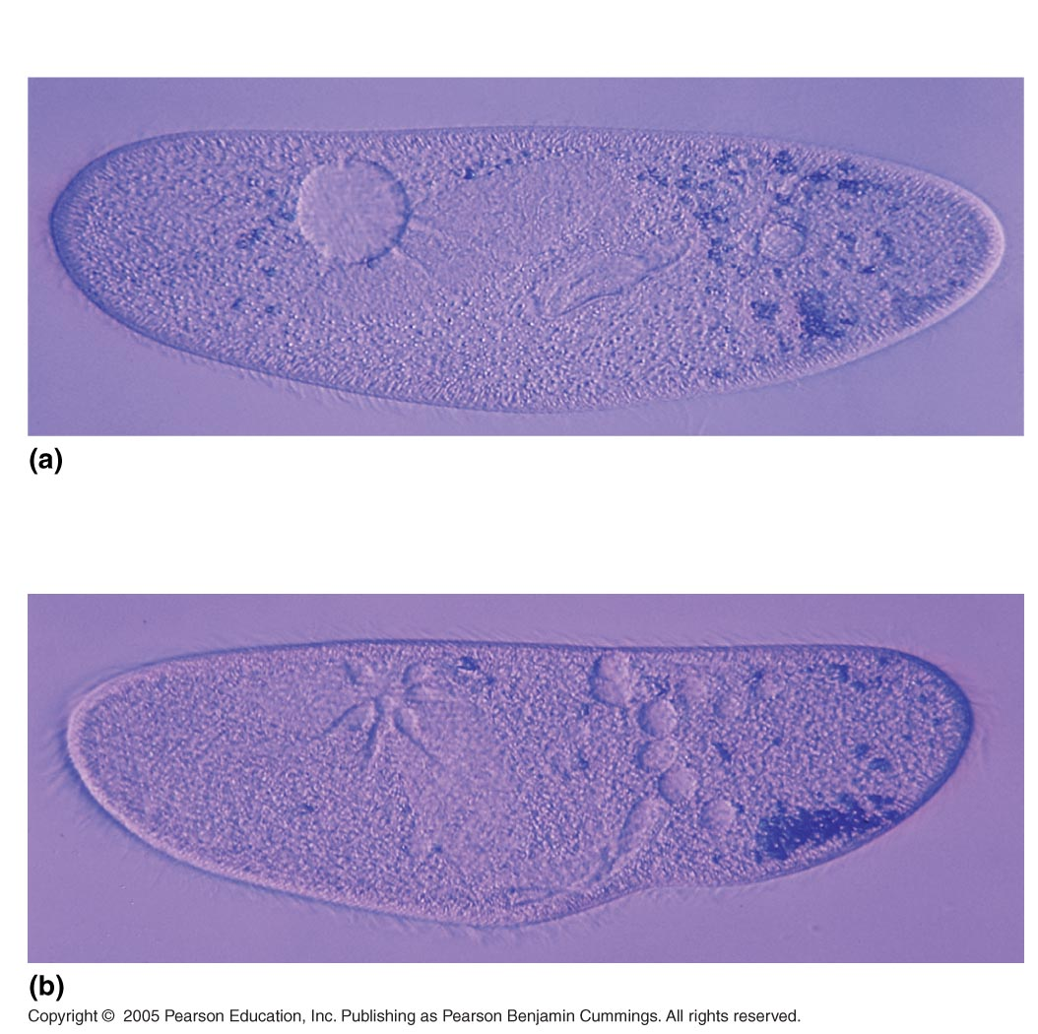
LE 7-14
50 µm
Filling vacuole
50 µm
Contracting vacuole

Slide 30
Water Balance of Cells with Walls
Plant cells have cell walls.
Cell walls are thicker then plasma membranes and do not burst.
This allows plants to survive in different environments.

Slide 31
LE 7-13
Saltwater solution
Isotonic solution
Distilled water
Animal
cell
H₂O
H₂O
H₂O
H₂O
Lysed
Normal
Shriveled
Plant
cell
H₂O
H₂O
H₂O
H₂O
?
Turgid (normal)
Flaccid
Plasmolyzed

Slide 32
LE 7-13
Hypotonic solution
Isotonic solution
Hypertonic solution
Animal
cell
H₂O
H₂O
H₂O
H₂O
Lysed
Normal
Shriveled
Plant
cell
H₂O
H₂O
H₂O
H₂O
?
Turgid (normal)
Flaccid
Plasmolyzed

Slide 33
LE 7-13
Hypotonic solution
Isotonic solution
Hypertonic solution
Animal
cell
H₂O
H₂O
H₂O
H₂O
Lysed
Normal
Shriveled
Plant
cell
H₂O
H₂O
H₂O
H₂O
?
Turgid (normal)
Flaccid
Plasmolyzed

Slide 34
LE 7-13
Hypotonic solution
Isotonic solution
Hypertonic solution
Animal
cell
H₂O
H₂O
H₂O
H₂O
Lysed
Normal
Shriveled
Plant
cell
H₂O
H₂O
H₂O
H₂O
Turgid (normal)
Flaccid
Plasmolyzed

Slide 35
Facilitated Diffusion
In facilitated diffusion, transport proteins aid movement of molecules across the plasma membrane
This increases the rate of transport.
This is considered passive transport because no energy is used.

Slide 36
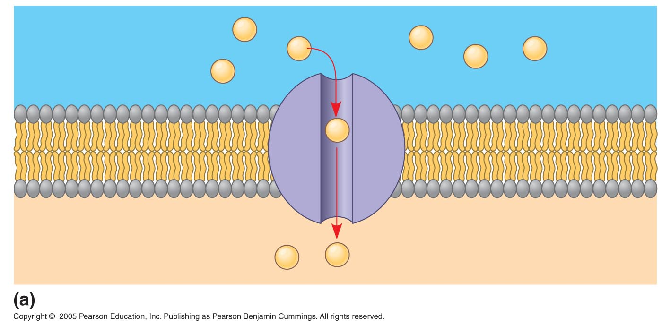
Channel proteins provide corridors that allow a specific molecule or ion to cross the membrane
EXTRACELLULAR
FLUID
Channel protein
Solute
CYTOPLASM

Slide 37
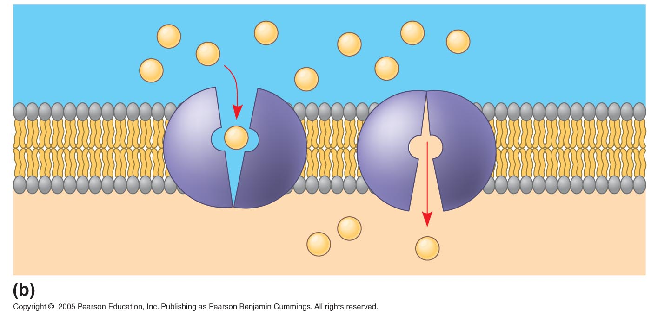
Carrier proteins undergo a subtle change in shape that translocates the solute-binding site across the membrane
Carrier protein
Solute

Slide 38
Active Transport
Active transport moves substances against their concentration gradient
Active transport requires energy, usually in the form of ATP
ATP is the smallest, most basic energy-containing molecule that cells use.
Active transport is performed by specific proteins embedded in the membranes

Slide 39
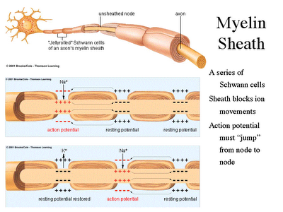
Neurons

Slide 40
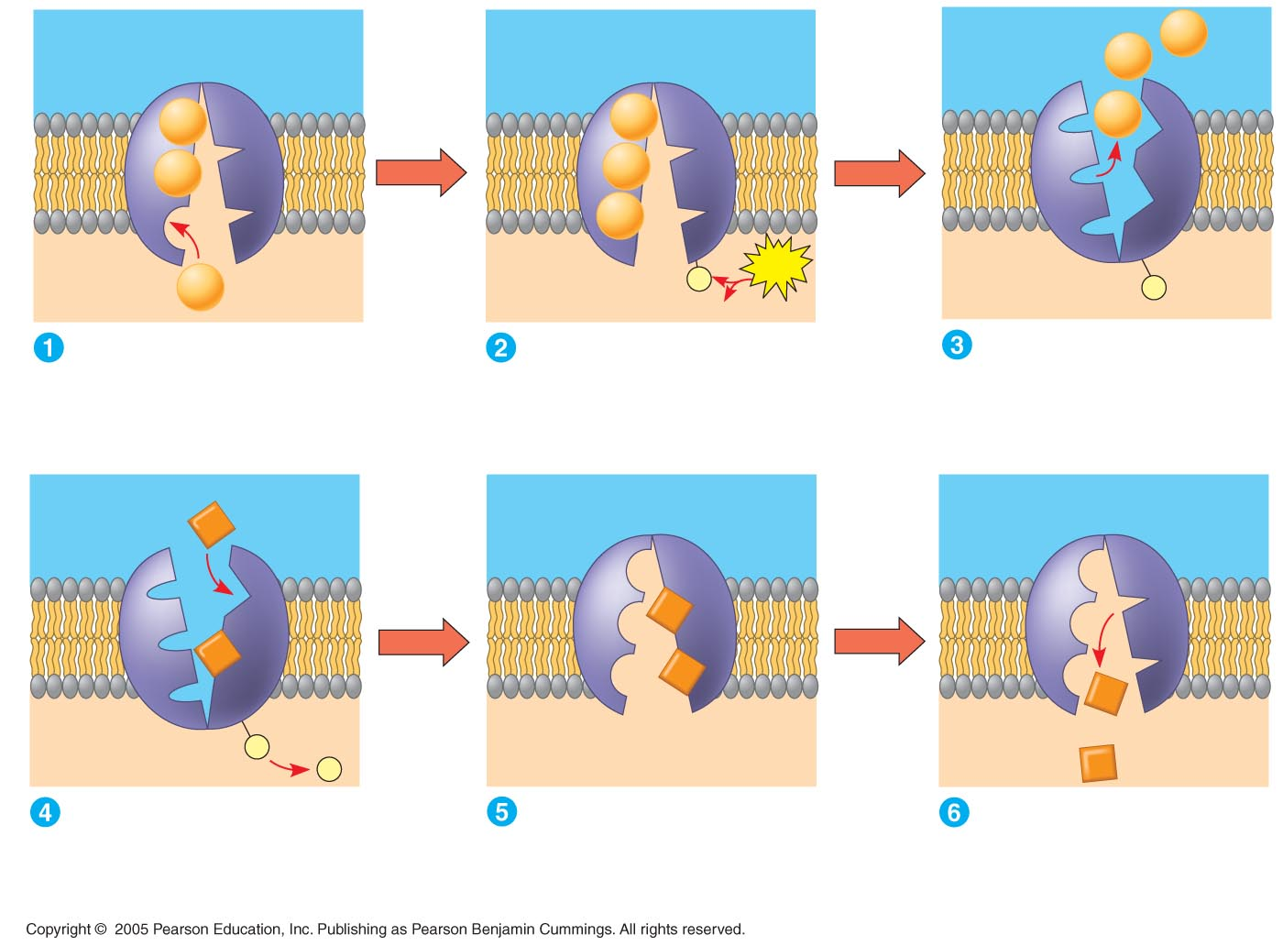
LE 7-16
EXTRACELLULAR
FLUID
[Na⁺] high
[K⁺] low
Na⁺
Na⁺
Na⁺
Na⁺
Na⁺
Na⁺
Na⁺
Na⁺
[Na⁺] low
[K⁺] high
P
ATP
CYTOPLASM
Na⁺
P
ADP
Na⁺ bonds to
the sodium-potassium pump
ATP is broken down into
ADP + P, generating energy.
The phosphorus causes the
protein to change shape,
releasing the sodium to the
Outside of the cell.
K⁺
K⁺
K⁺
K⁺
K⁺
P
K⁺
P
Potassium from outside the
cell bonds to the protein pump,
causing the phosphorus to be
removed.
The potassium is released
to the inside of the cell and
the protein returns to its
original shape.
The protein is now
ready to repeat the process.

Slide 41
LE 7-16
EXTRACELLULAR
FLUID
[Na⁺] high
[K⁺] low
Na⁺
Na⁺
Na⁺
Na⁺
Na⁺
Na⁺
Na⁺
Na⁺
[Na⁺] low
[K⁺] high
P
ATP
CYTOPLASM
Na⁺
P
ADP
Na⁺ bonds to
the sodium-potassium pump
ATP is broken down into
ADP + P, generating energy.
The phosphorus causes the
protein to change shape,
releasing the sodium to the
Outside of the cell.
K⁺
K⁺
K⁺
K⁺
K⁺
P
K⁺
P
Potassium from outside the
cell bonds to the protein pump,
causing the phosphorus to be
removed.
The potassium is released
to the inside of the cell and
the protein returns to its
original shape.
The protein is now
ready to repeat the process.

Slide 42
LE 7-16
EXTRACELLULAR
FLUID
[Na⁺] high
[K⁺] low
Na⁺
Na⁺
Na⁺
Na⁺
Na⁺
Na⁺
Na⁺
Na⁺
[Na⁺] low
[K⁺] high
P
ATP
CYTOPLASM
Na⁺
P
ADP
Na⁺ bonds to
the sodium-potassium pump
ATP is broken down into
ADP + P, generating energy.
The phosphorus causes the
protein to change shape,
releasing the sodium to the
Outside of the cell.
K⁺
K⁺
K⁺
K⁺
K⁺
P
K⁺
P
Potassium from outside the
cell bonds to the protein pump,
causing the phosphorus to be
removed.
The potassium is released
to the inside of the cell and
the protein returns to its
original shape.
The protein is now
ready to repeat the process.

Slide 43
LE 7-16
EXTRACELLULAR
FLUID
[Na⁺] high
[K⁺] low
Na⁺
Na⁺
Na⁺
Na⁺
Na⁺
Na⁺
Na⁺
Na⁺
[Na⁺] low
[K⁺] high
P
ATP
CYTOPLASM
Na⁺
P
ADP
Na⁺ bonds to
the sodium-potassium pump
ATP is broken down into
ADP + P, generating energy.
The phosphorus causes the
protein to change shape,
releasing the sodium to the
Outside of the cell.
K⁺
K⁺
K⁺
K⁺
K⁺
P
K⁺
P
Potassium from outside the
cell bonds to the protein pump,
causing the phosphorus to be
removed.
The potassium is released
to the inside of the cell and
the protein returns to its
original shape.
The protein is now
ready to repeat the process.

Slide 44
LE 7-16
EXTRACELLULAR
FLUID
[Na⁺] high
[K⁺] low
Na⁺
Na⁺
Na⁺
Na⁺
Na⁺
Na⁺
Na⁺
Na⁺
[Na⁺] low
[K⁺] high
P
ATP
CYTOPLASM
Na⁺
P
ADP
Na⁺ bonds to
the sodium-potassium pump
ATP is broken down into
ADP + P, generating energy.
The phosphorus causes the
protein to change shape,
releasing the sodium to the
Outside of the cell.
K⁺
K⁺
K⁺
K⁺
K⁺
P
K⁺
P
Potassium from outside the
cell bonds to the protein pump,
causing the phosphorus to be
removed.
The potassium is released
to the inside of the cell and
the protein returns to its
original shape.
The protein is now
ready to repeat the process.

Slide 45
LE 7-16
EXTRACELLULAR
FLUID
[Na⁺] high
[K⁺] low
Na⁺
Na⁺
Na⁺
Na⁺
Na⁺
Na⁺
Na⁺
Na⁺
[Na⁺] low
[K⁺] high
P
ATP
CYTOPLASM
Na⁺
P
ADP
Na⁺ bonds to
the sodium-potassium pump
ATP is broken down into
ADP + P, generating energy.
The phosphorus causes the
protein to change shape,
releasing the sodium to the
Outside of the cell.
K⁺
K⁺
K⁺
K⁺
K⁺
P
K⁺
P
Potassium from outside the
cell bonds to the protein pump,
causing the phosphorus to be
removed.
The potassium is released
to the inside of the cell and
the protein returns to its
original shape.
The protein is now
ready to repeat the process.

Slide 46
Cotransport
Cotransport occurs when active transport of a solute indirectly drives transport of another solute.

Slide 47
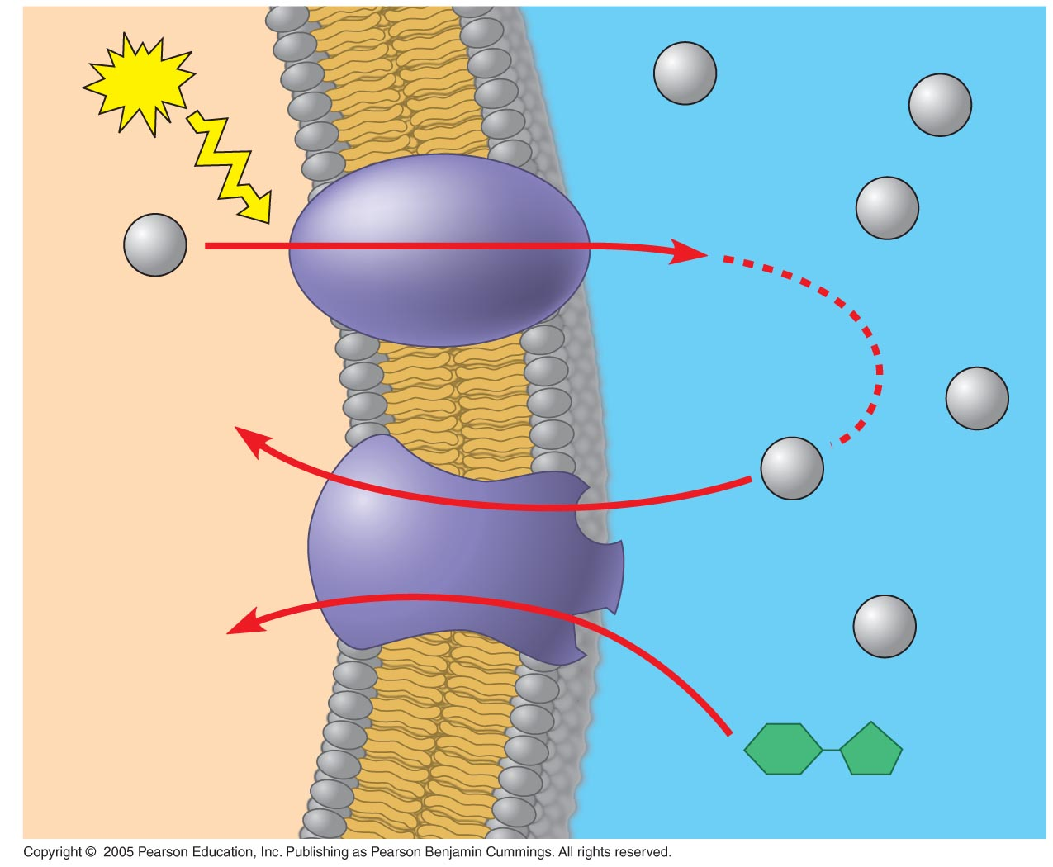
LE 7-19
–
+
ATP
H⁺
H⁺
–
+
Proton pump
H⁺
H⁺
–
+
–
H⁺
+
H⁺
Diffusion
of H⁺
Sucrose-H⁺
cotransporter
H⁺
–
+
–
+
Sucrose

Slide 48
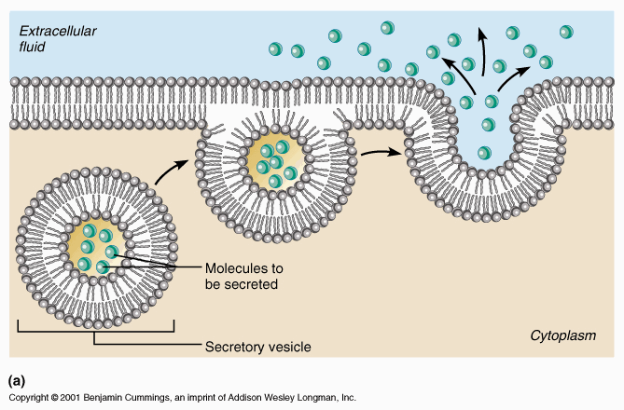
Exocytosis
In exocytosis, transport vesicles from the Golgi fuse with the cell membrane and release their contents to the outside.

Slide 49
Endocytosis
In endocytosis, the cell takes in large molecules by forming vesicles from the plasma membrane
Endocytosis is a reversal of exocytosis.
Three types of endocytosis:
Phagocytosis (“cellular eating”): Cell engulfs particle in a vacuole
Pinocytosis (“cellular drinking”): Cell creates vesicle around fluid
Receptor-mediated: Particles or fluid must bond to protein receptors first, then are engulfed.

Slide 50
